Slide 1
IQ puzzles and brain teasers
Level 2C

Slide 2
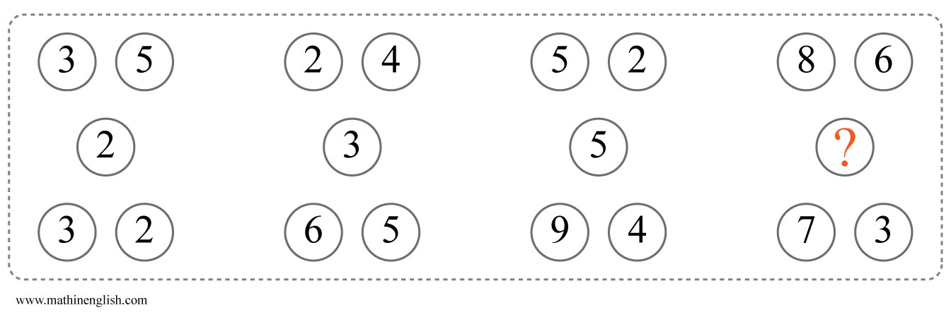
IQ Puzzle 1
Level 2C
Which number is missing?

Slide 3
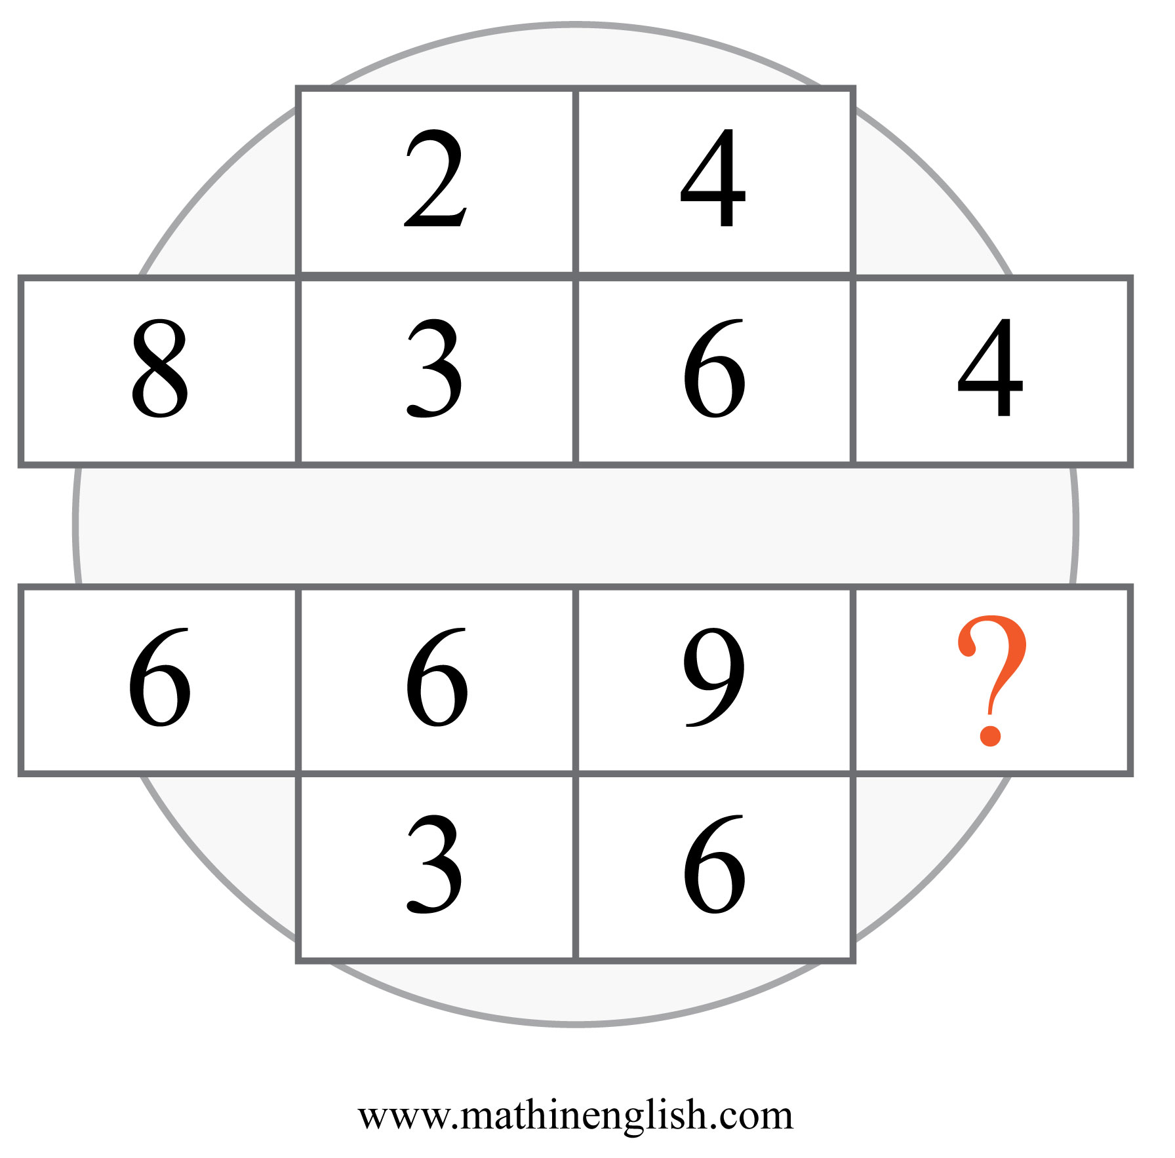
IQ Puzzle 2
Level 2C
Which number is missing?

Slide 4
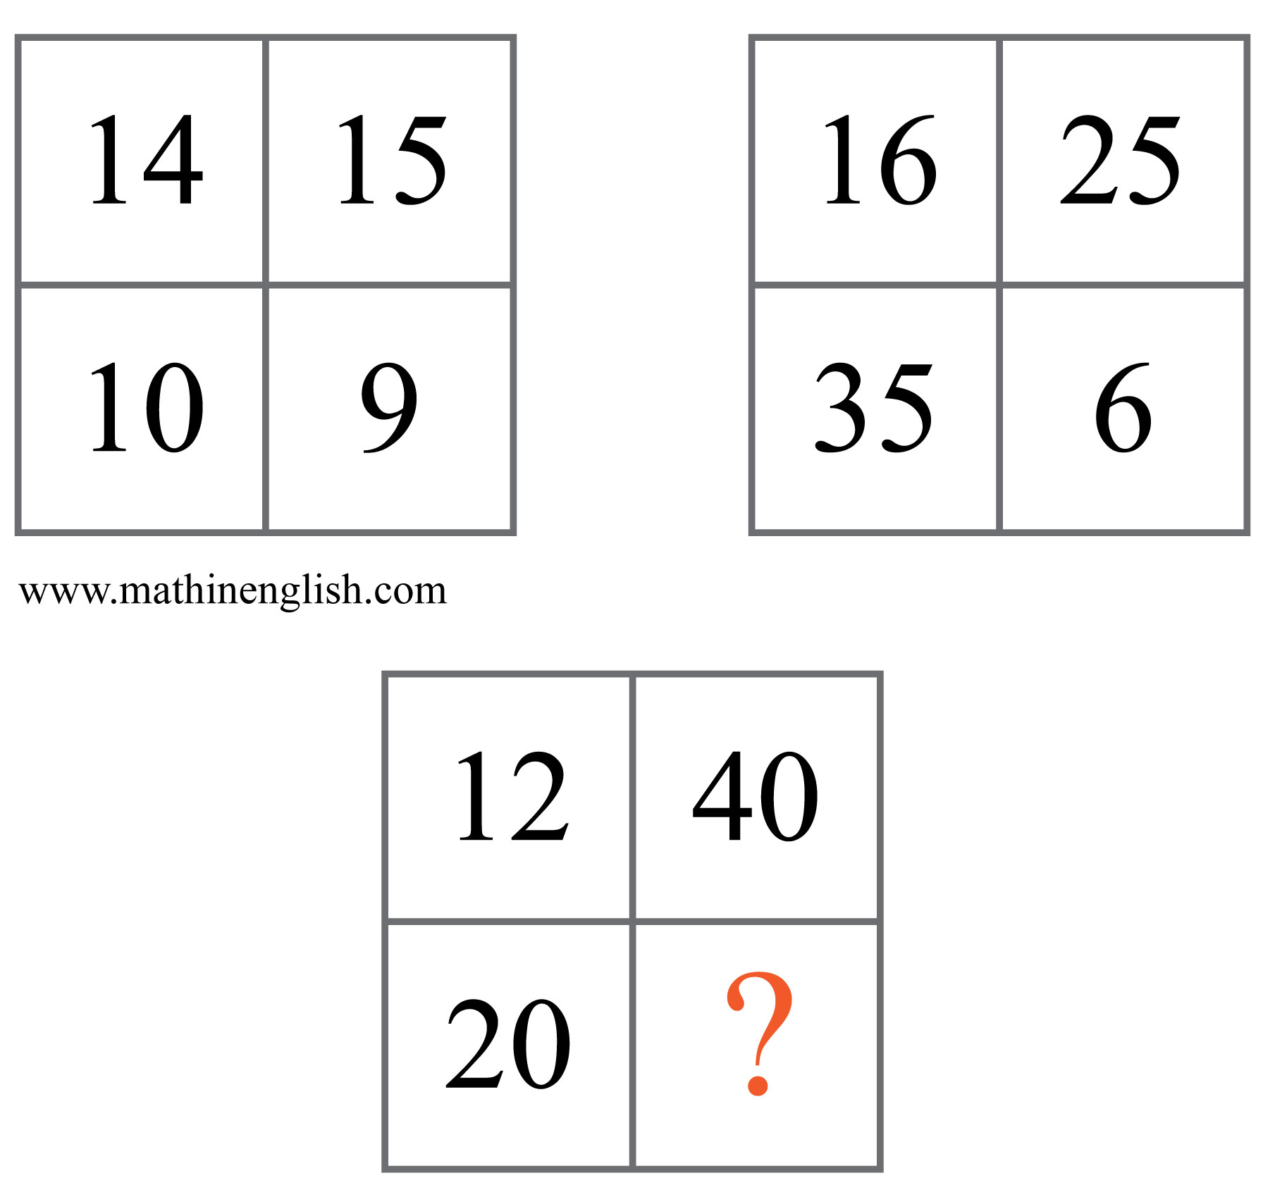
IQ Puzzle 3
Level 2C
What is the missing number?

Slide 5
IQ Puzzle 4
Level 2C
What number is needed here?

Slide 6
IQ Puzzle 5
Level 2C
Which number is needed?

Slide 7
IQ Puzzle 6
Level 2C
Which number is missing?

Slide 8
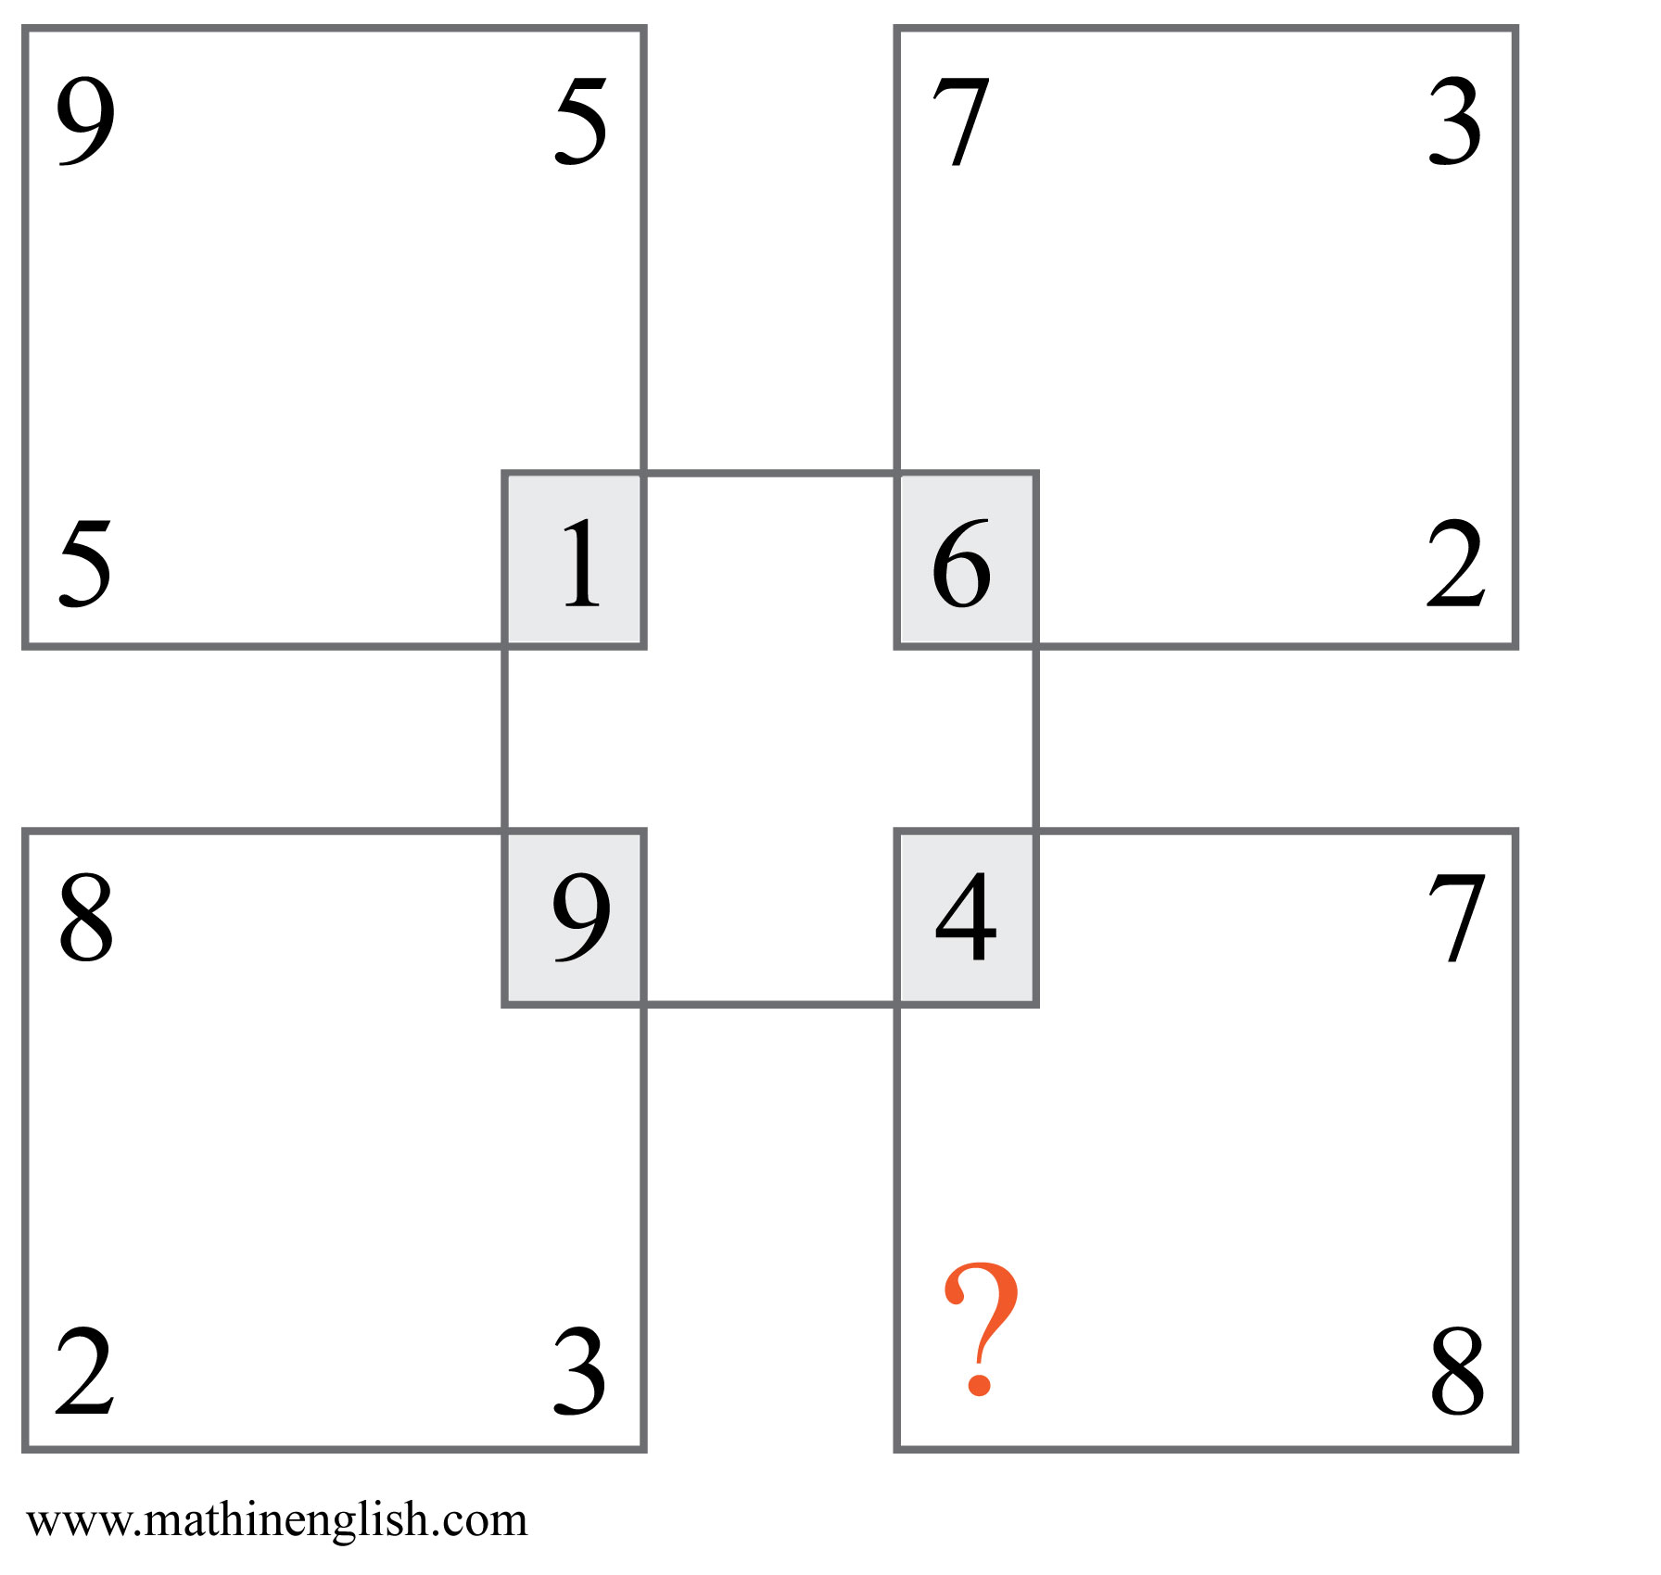
IQ Puzzle 7
Level 2C
Which number is missing?

Slide 9
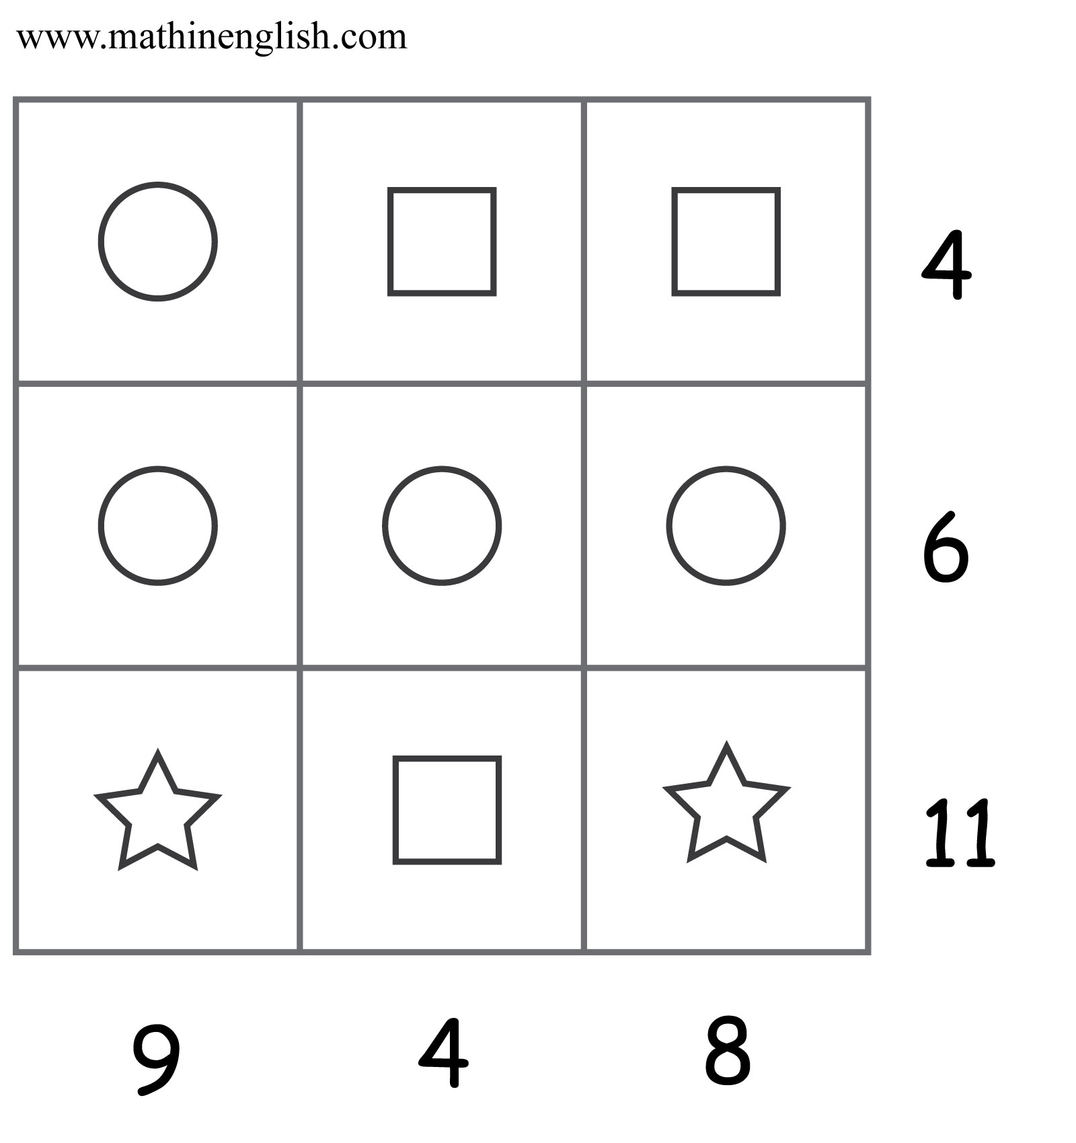
IQ Puzzle 8
Level 2C
What is the value of the shapes?

Slide 10
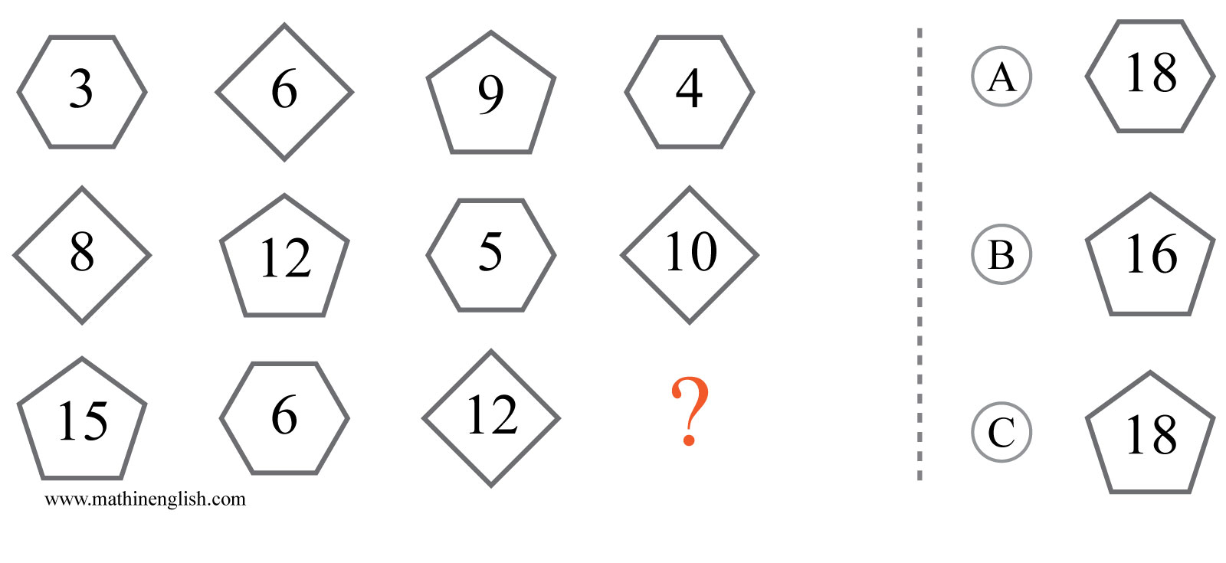
IQ Puzzle 9
Level 2C
Which option is correct?

Slide 11
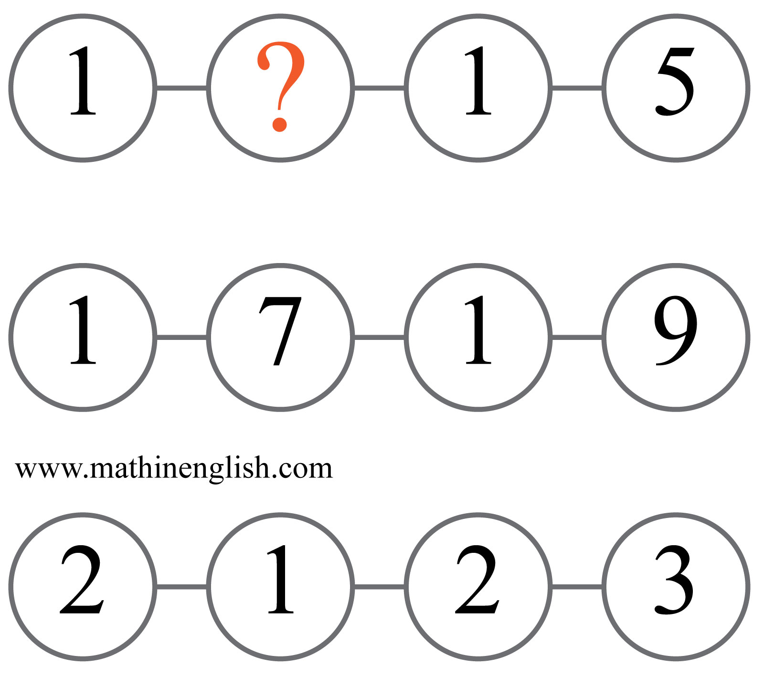
IQ Puzzle 10
Level 2C
Which number is missing?

Slide 12
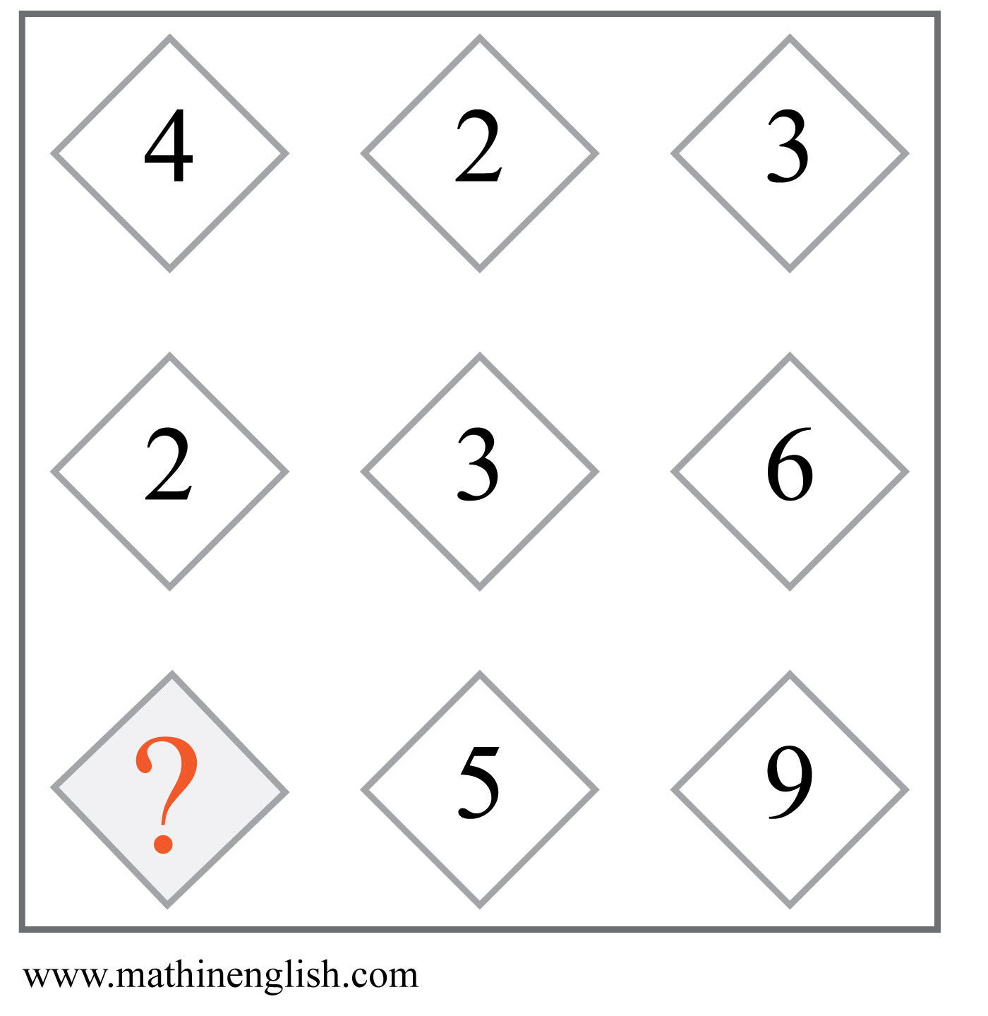
IQ Puzzle 11
Level 2C
Which number is missing?

Slide 13
IQ Puzzle 12
Level 2C
Which number is missing?

Slide 14
IQ Puzzle 13
Level 2C
Which letter is missing?

Slide 15
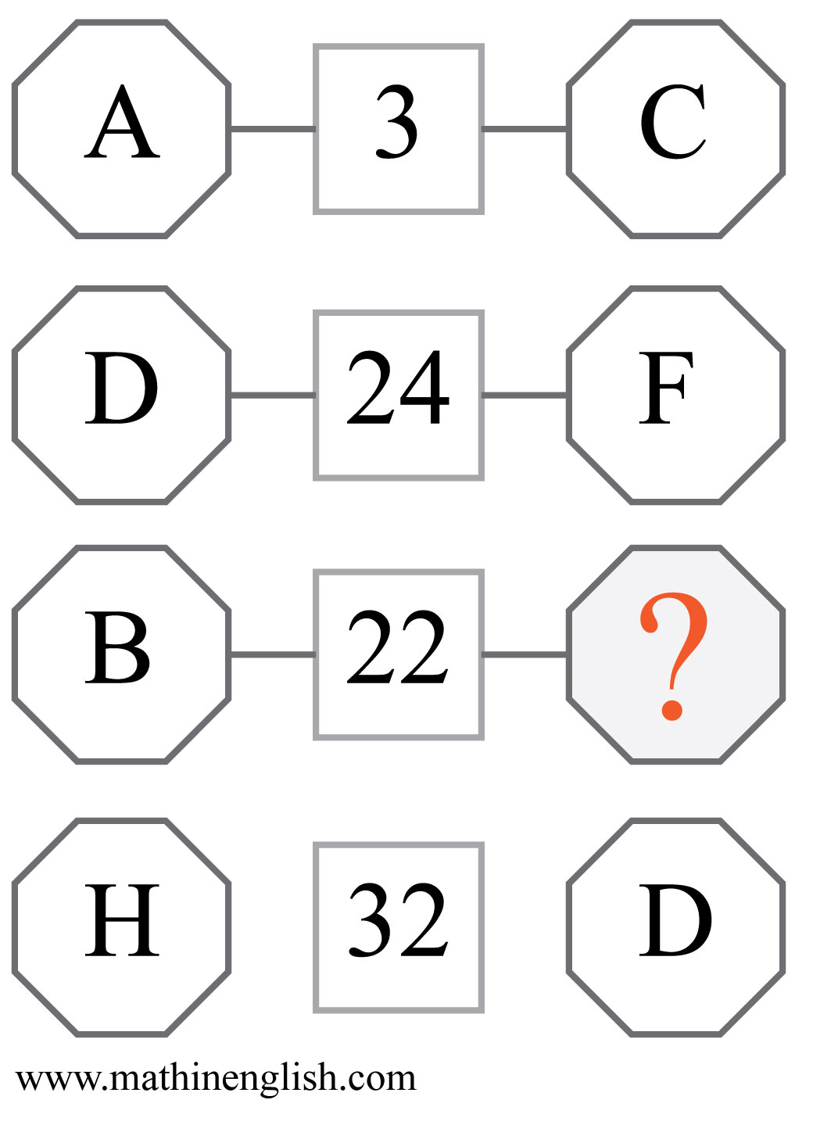
IQ Puzzle 14
Level 2C
What is the missing letter?

Slide 16
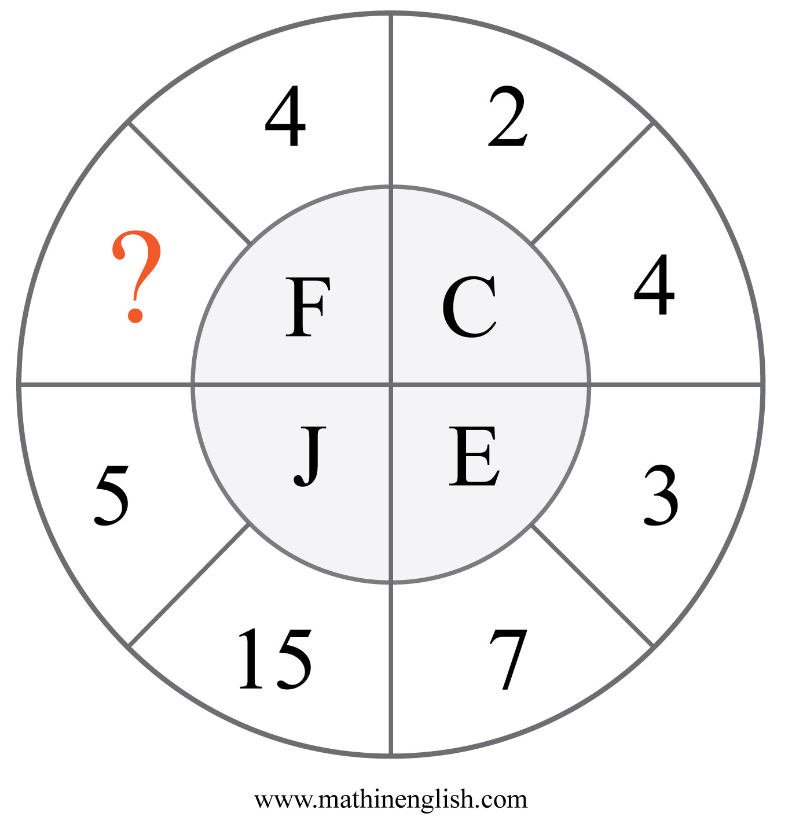
IQ Puzzle 15
Level 2C
Which number is missing?

Slide 17
IQ Puzzle 16
Level 2C
Which number is missing?

Slide 18
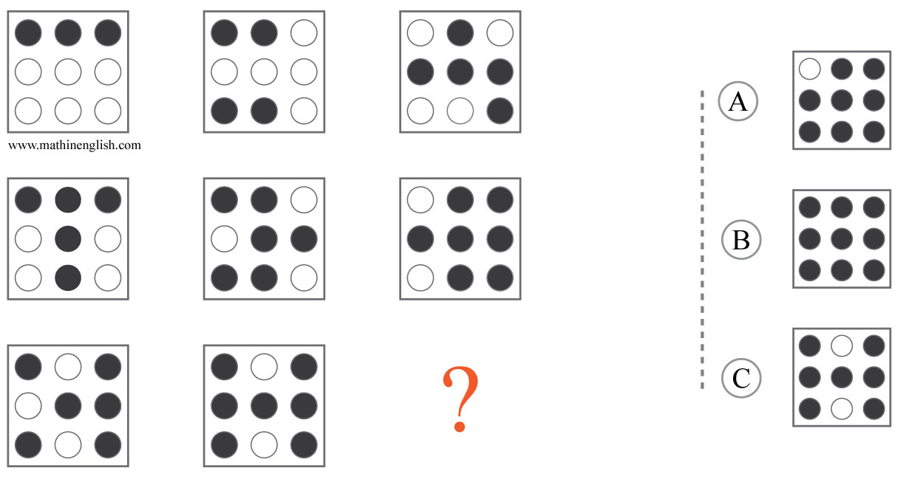
IQ Puzzle 17
Level 2C
Which option is correct?

Slide 19
IQ Puzzle 18
Level 2C
Which number is missing?

Slide 20
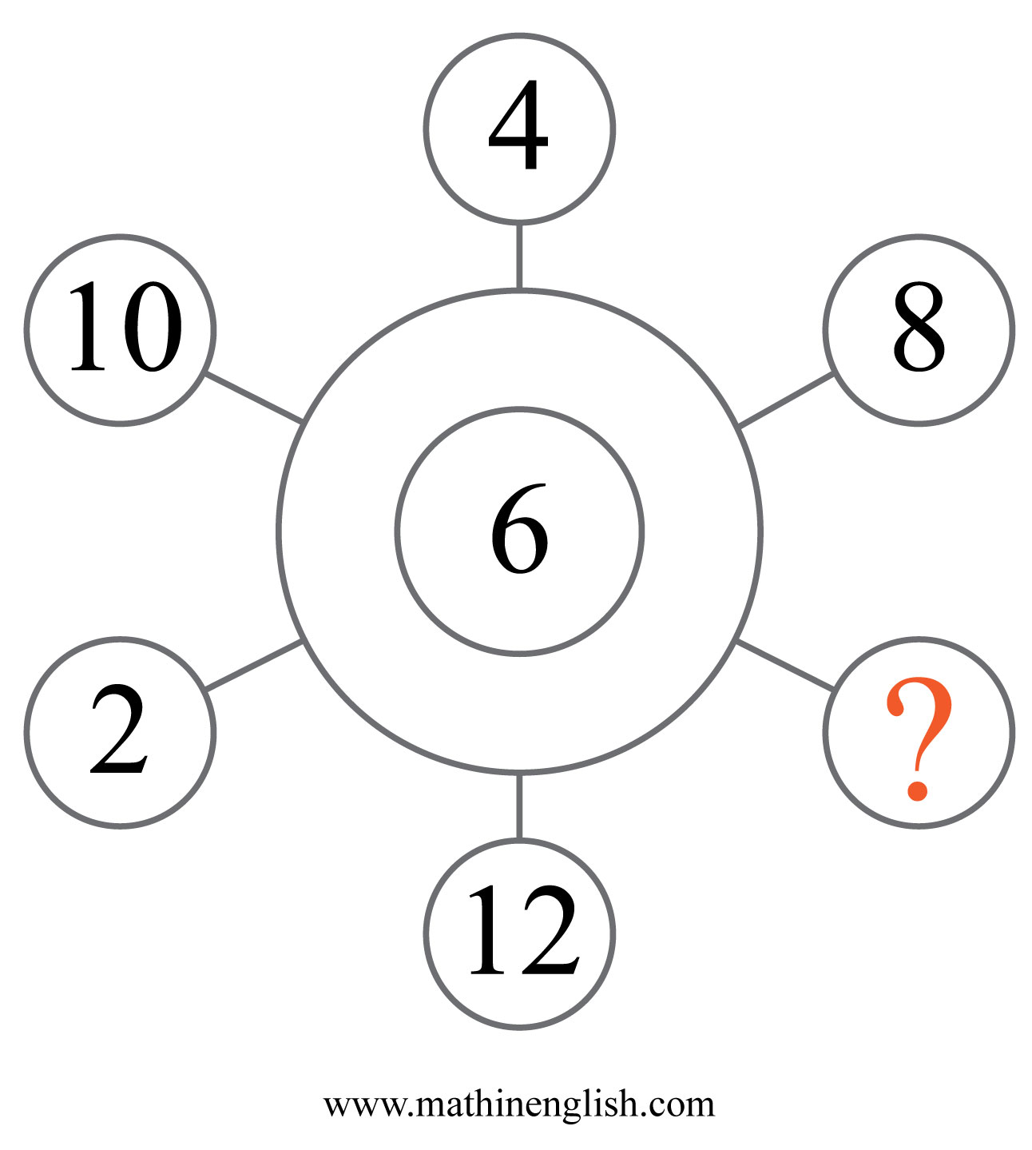
IQ Puzzle 19
Level 2C
Which number is missing?

Slide 21
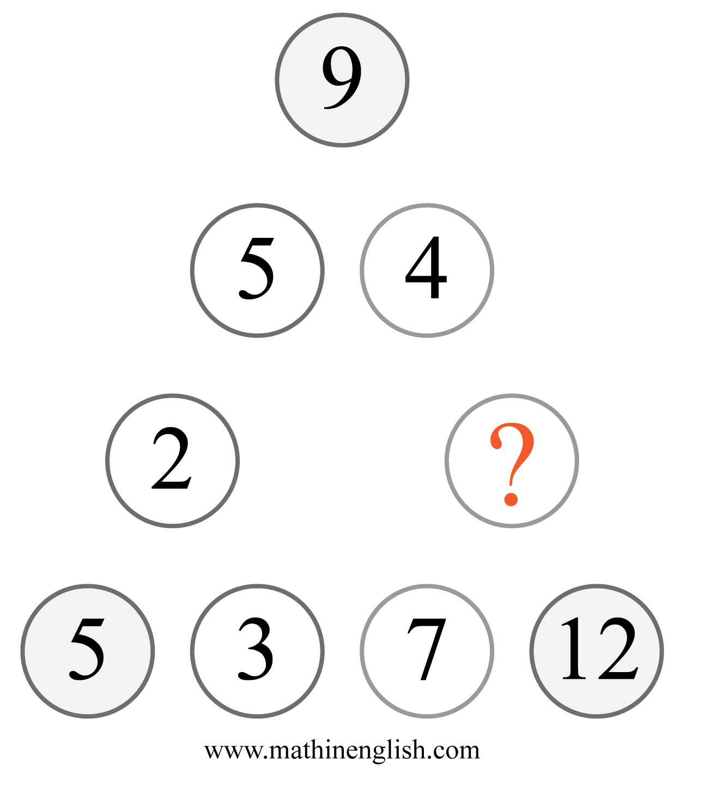
IQ Puzzle 20
Level 2C
Which number is missing?

Slide 22
Answers to puzzles 1 to 4
puzzle 1 : 6
The different groups of cells should add up to 15, 20, 25 and
30.
puzzle 2 : 4
9 times 4 and 6 times are 36, the bottom 2 cells. Same applies for top.
puzzle 3 : 32
The difference in values of each cross pair in a square is the same
(14 - 9 = 15 - 10).
puzzle 4 : I
The letter in the center is the sum of the other numbers in
each set divided by 10.
Copyright: www.mathinenglish.com
Level 2C

Slide 23
Answers to puzzles 5 to 8
puzzle 5 : 3
Add 1 to each cell in the 1st cross to get the 2nd. Do the same to the
cells in the 2nd to get the 3rd cross.
puzzle 6 : 3
The sum of the 2 horizontally adjacent cells multiplied by 2
forms the value the 3rd cell.
puzzle 7 : 5
The sum of the opposite numbers in each square is equal.
puzzle 8 : 1
Fill in and check all equations.
Copyright: www.mathinenglish.com
Level 2C

Slide 24
Answers to puzzles 9 to 12
puzzle 9 : C
Shape pattern with hexagon, diamond and pentagon.
Pentagons follow a 9, 12 , 15 and 18 pattern.
puzzle 10 : 3
13,15,17,19,21,23 sequence.
puzzle 11 : 6
423 + 236 equals 659.
puzzle 12 : 28
Each hexagon contains the 2nd to the 7th multiple of respectively
6, 5 and 4.
Copyright: www.mathinenglish.com
Level 2C

Slide 25
Answers to puzzles 13 to 16
puzzle 13 : 2
The legs in the first shape add up to 10, 11 in the 2nd and 12 in the 3rd.
puzzle 14 : K
B times K, or 2 times 11 is 22.
puzzle 15 : 8
The average of 8 and D, 8 and 4, is 6, or F.
puzzle 16 : 31
The average of the 4 corner numbers plus 1.
Copyright: www.mathinenglish.com
Level 2C

Slide 26
Answers to puzzles 17 to 20
puzzle 17 : A
Each next shape has +1 shaded dot in each row.
puzzle 18 : 40
The sequence follows a ×2 + 4 pattern.
puzzle 19 : 14
14 is the missing multiple of 2 in this sequence.
puzzle 20 : 5
The corner numbers are the sum of its 2 adjacent numbers.
Copyright: www.mathinenglish.com
Level 2C

