Slide 1
IQ puzzles and brain teasers
Level 2B

Slide 2
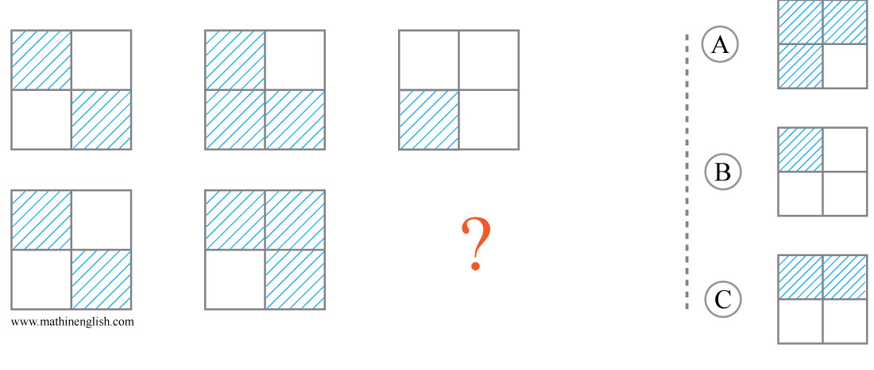
IQ Puzzle 1
Level 2B
Which option is correct?

Slide 3
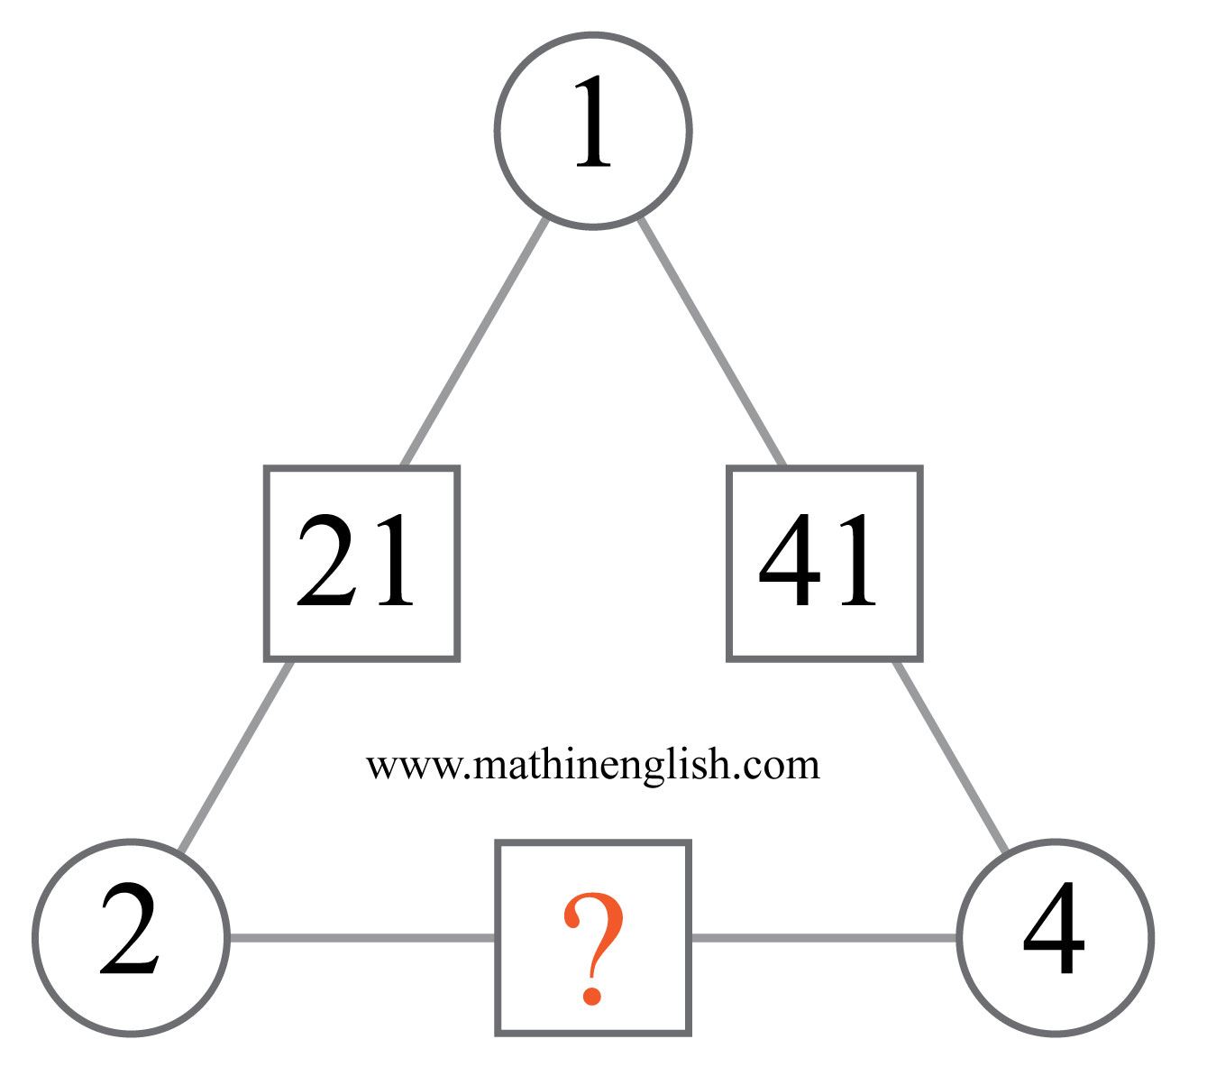
IQ Puzzle 2
Level 2B
Which number is missing?

Slide 4
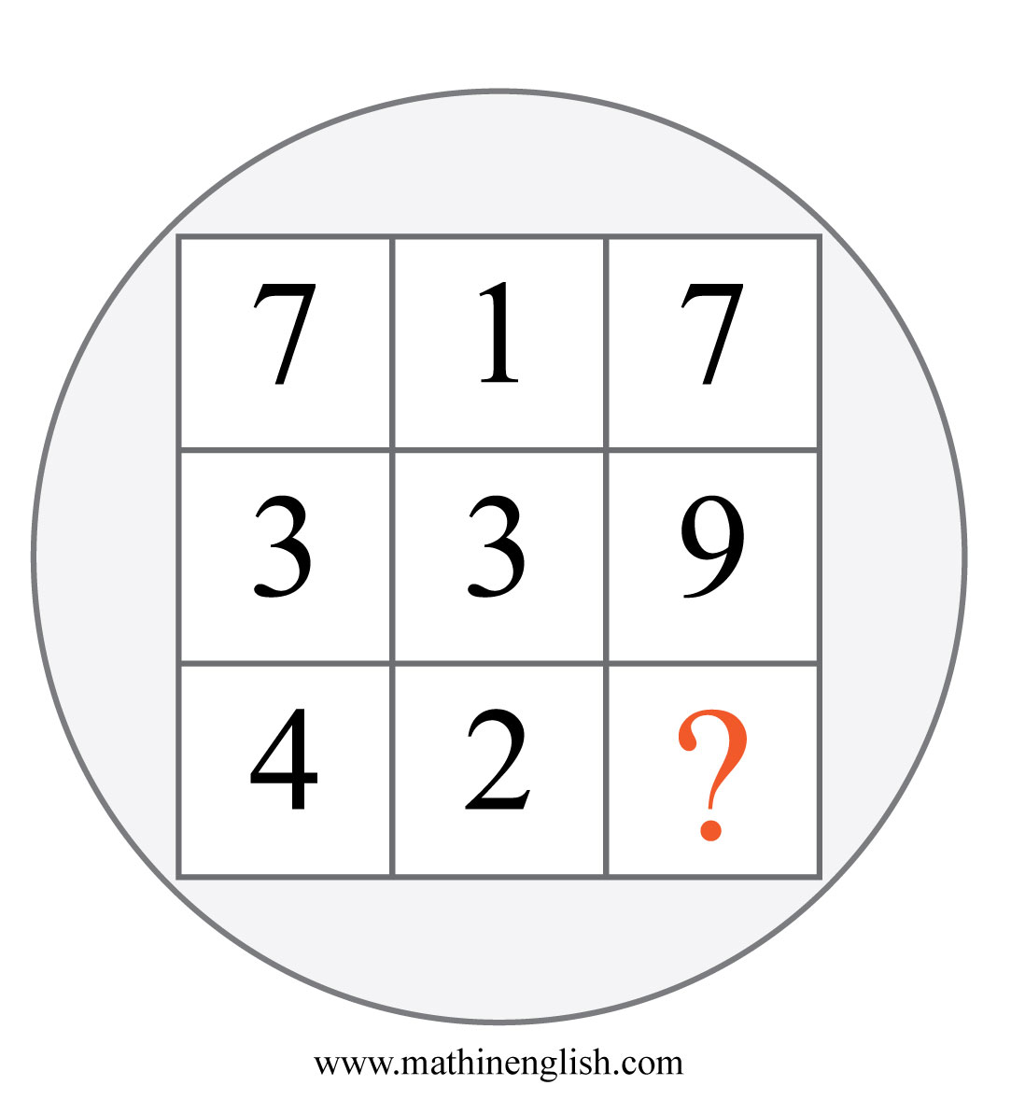
IQ Puzzle 3
Level 2B
What is the missing number?

Slide 5
IQ Puzzle 4
Level 2B
What number is needed here?

Slide 6
IQ Puzzle 5
Level 2B
Which number is needed?

Slide 7
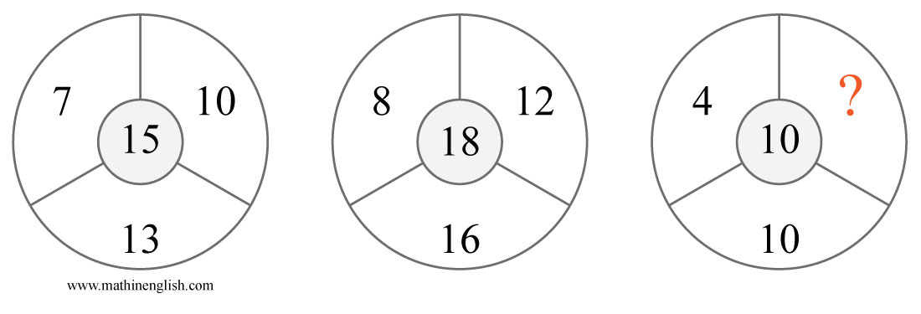
IQ Puzzle 6
Level 2B
Which number is missing?

Slide 8
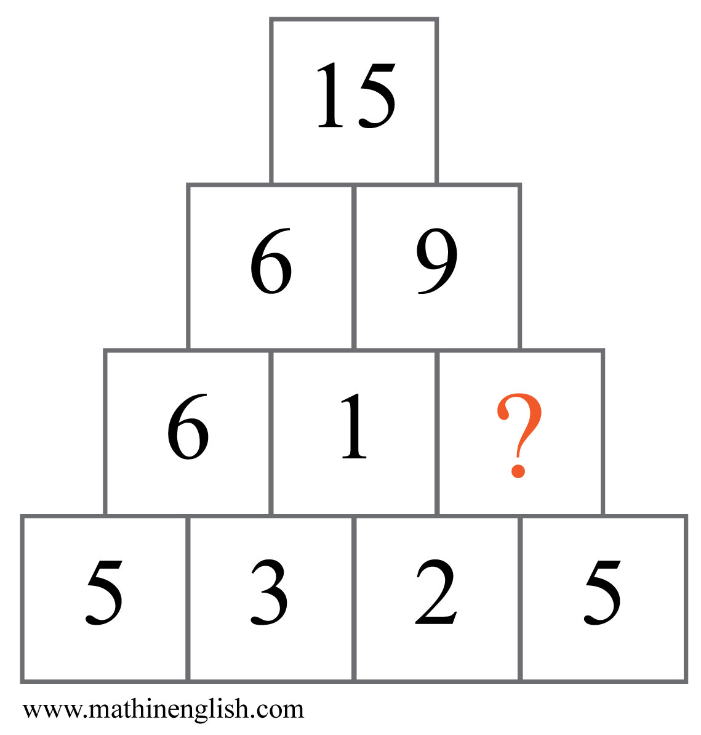
IQ Puzzle 7
Level 2B
Which number is missing?

Slide 9
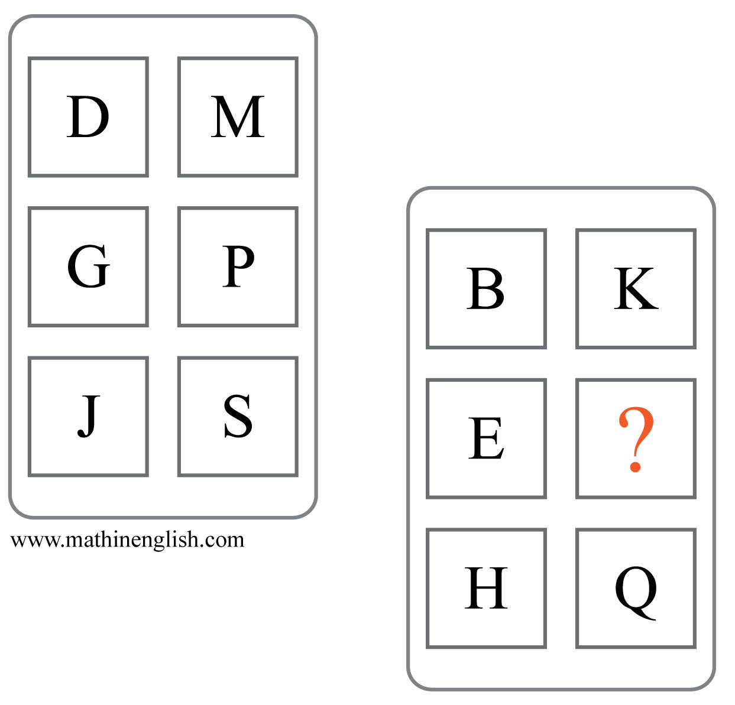
IQ Puzzle 8
Level 2B
Which letter completes the pattern?

Slide 10
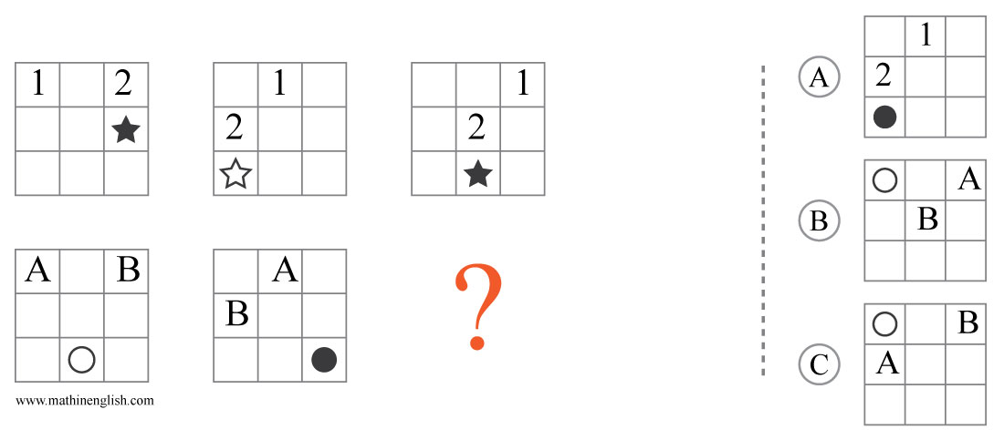
IQ Puzzle 9
Level 2B
Which option is correct?

Slide 11
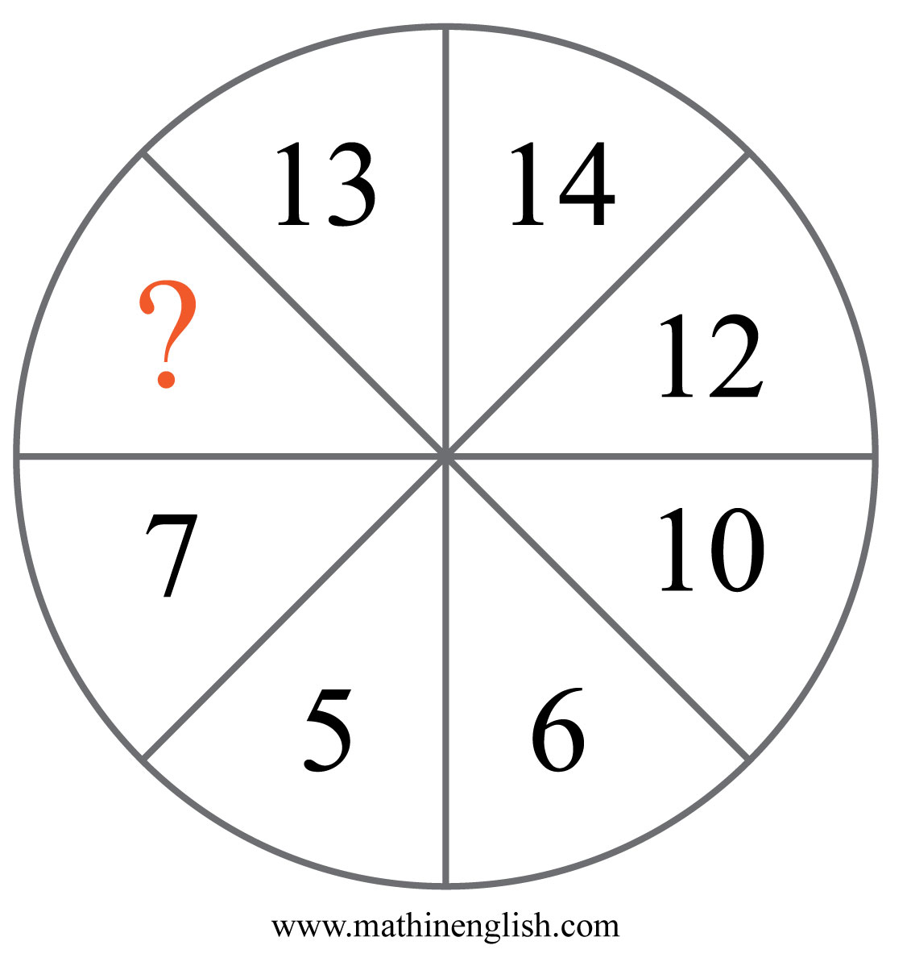
IQ Puzzle 10
Level 2B
Which number is missing?

Slide 12
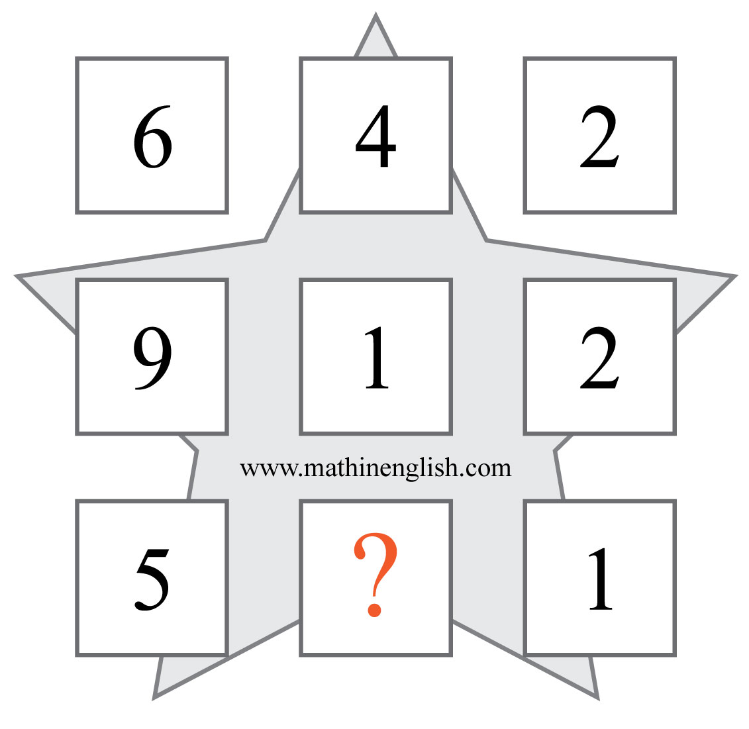
IQ Puzzle 11
Level 2B
Which number is missing?

Slide 13
IQ Puzzle 12
Level 2B
Which letter is missing?

Slide 14
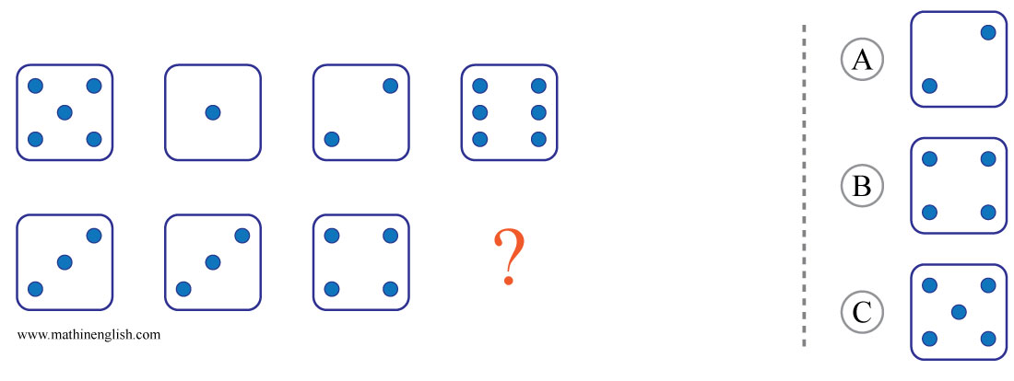
IQ Puzzle 13
Level 2B
Which option is correct?

Slide 15
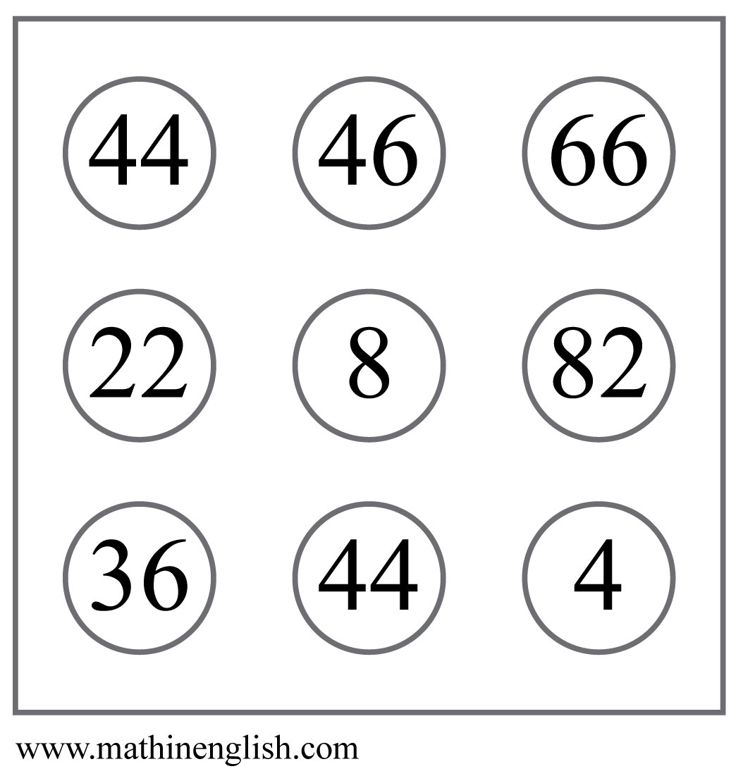
IQ Puzzle 14
Level 2B
What is the odd number out?

Slide 16
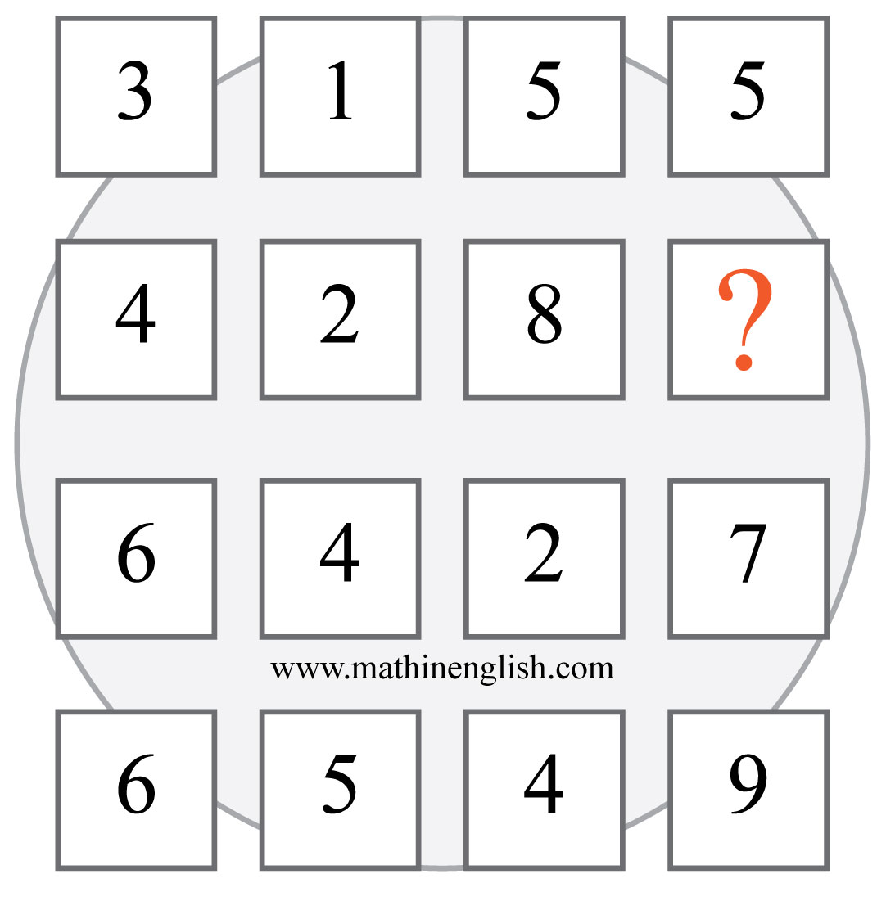
IQ Puzzle 15
Level 2B
Which number is missing?

Slide 17
IQ Puzzle 16
Level 2B
Which letter is missing?

Slide 18
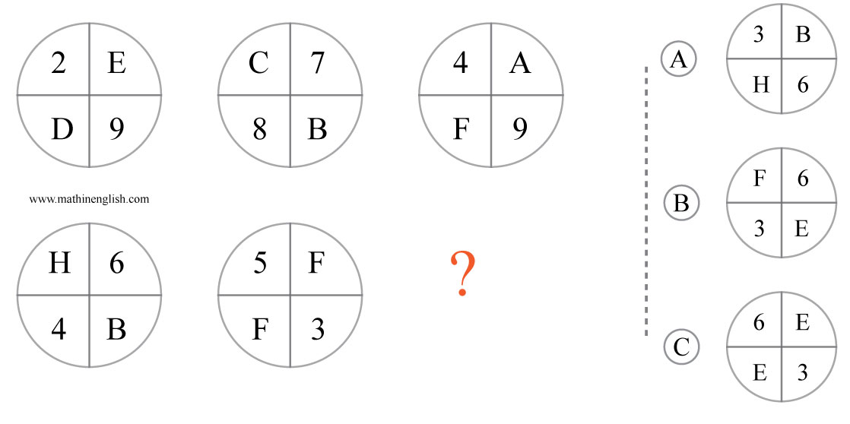
IQ Puzzle 17
Level 2B
Which option is correct?

Slide 19
IQ Puzzle 18
Level 2B
Which number is missing?

Slide 20
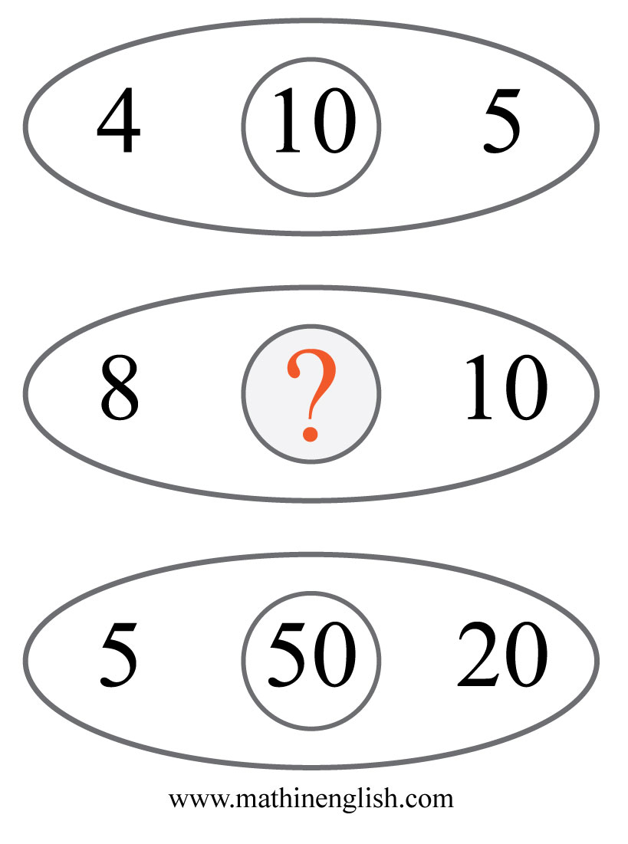
IQ Puzzle 19
Level 2B
Which number is missing?

Slide 21
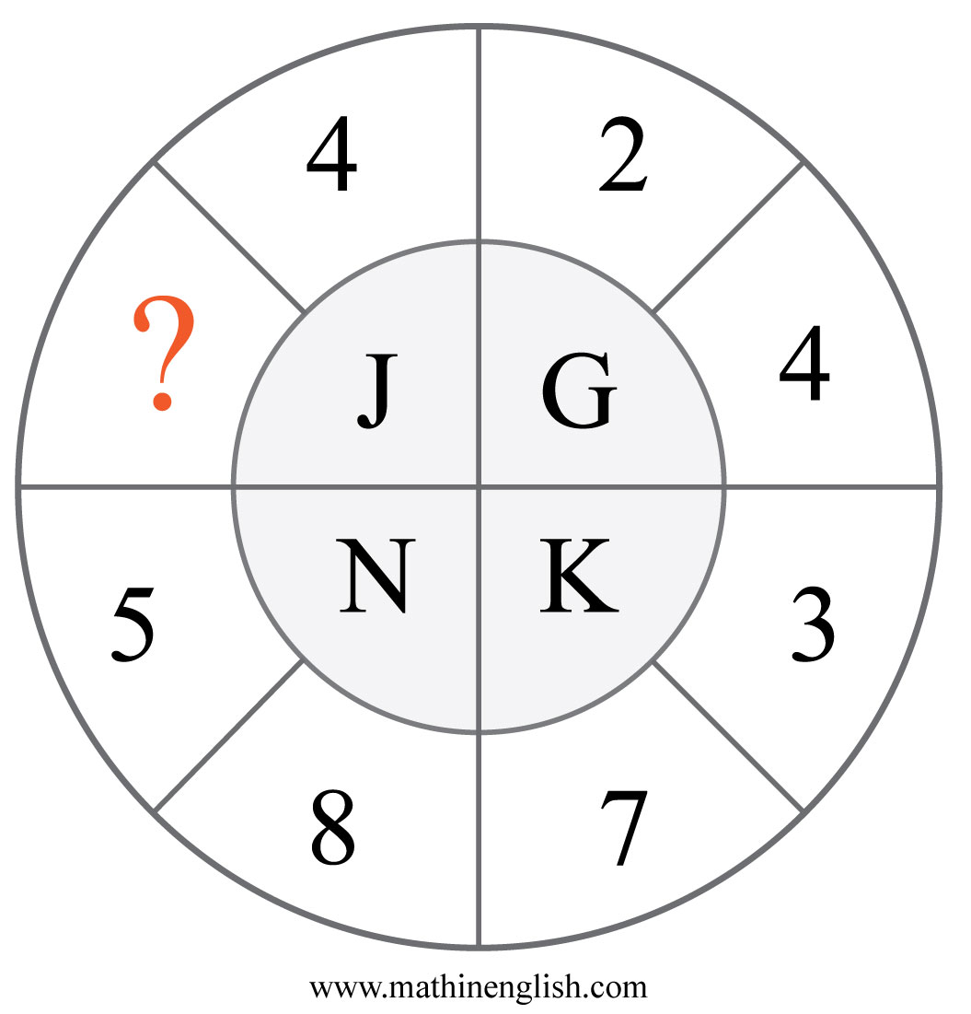
IQ Puzzle 20
Level 2B
Which number is missing?

Slide 22
Answers to puzzles 1 to 4
puzzle 1 : C
The sum of the shaded parts of the 1st and 3rd square form the
middle square .
puzzle 2 : 42
The biggest number the 2 connecting digits can form is 42.
puzzle 3 : 8
4 times 2 equals 8.
puzzle 4 : 2
Divide the lower 3 cells in each diamond by 2 to get the top cell.
Copyright: www.mathinenglish.com
Level 2B

Slide 23
Answers to puzzles 5 to 8
puzzle 5 : 8
8 is needed to make the equation correct.
puzzle 6 : 6
The center number is the sum of the 3 numbers divided by 2.
puzzle 7 : 8
Each row in the pyramid add up to 15.
puzzle 8 : N
Each column follows a +3 letter value pattern.
Copyright: www.mathinenglish.com
Level 2B

Slide 24
Answers to puzzles 9 to 12
puzzle 9 : B
The symbols move 1 place each next square and the shapes change
from shaded to non shaded.
puzzle 10 : 9
All opposite pairs add up to 19.
puzzle 11 : 6
Each row adds up to 12.
puzzle 12 : P
D times 4 makes 16, or P.
Copyright: www.mathinenglish.com
Level 2B

Slide 25
Answers to puzzles 13 to 16
puzzle 13 : B
The difference between the dice in the top row and those in the
bottom row is 2.
puzzle 14 : 36
36 is the only number with an odd digit in it.
puzzle 15 : 7
In each row the left and right number multiply to the 2 in the
middle.
puzzle 16 : H
The sequence follows a +2 and minus 1 letter value pattern.
Copyright: www.mathinenglish.com
Level 2B

Slide 26
Answers to puzzles 17 to 20
puzzle 17 : B
The numbers and letters in each circle add up to 20.
puzzle 18 : 80
The sequence follows a divide by 2, times 4 pattern.
puzzle 19 : 40
In each row multiply the number on the left with the one on the
right and then divide by 2.
puzzle 20 : 5
Add the 2 numbers in each part and add 1 to the sum to get the
letter value.
Copyright: www.mathinenglish.com
Level 2B

