Slide 1
IQ puzzles and brain teasers
Level 2A

Slide 2
IQ Puzzle 1
Level 2A
What is the missing number?

Slide 3
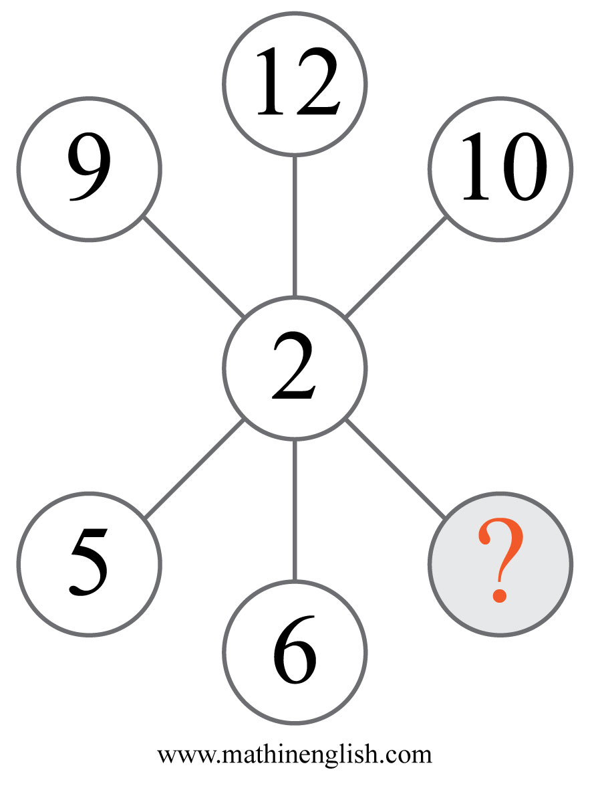
IQ Puzzle 2
Level 2A
Which number is missing?

Slide 4
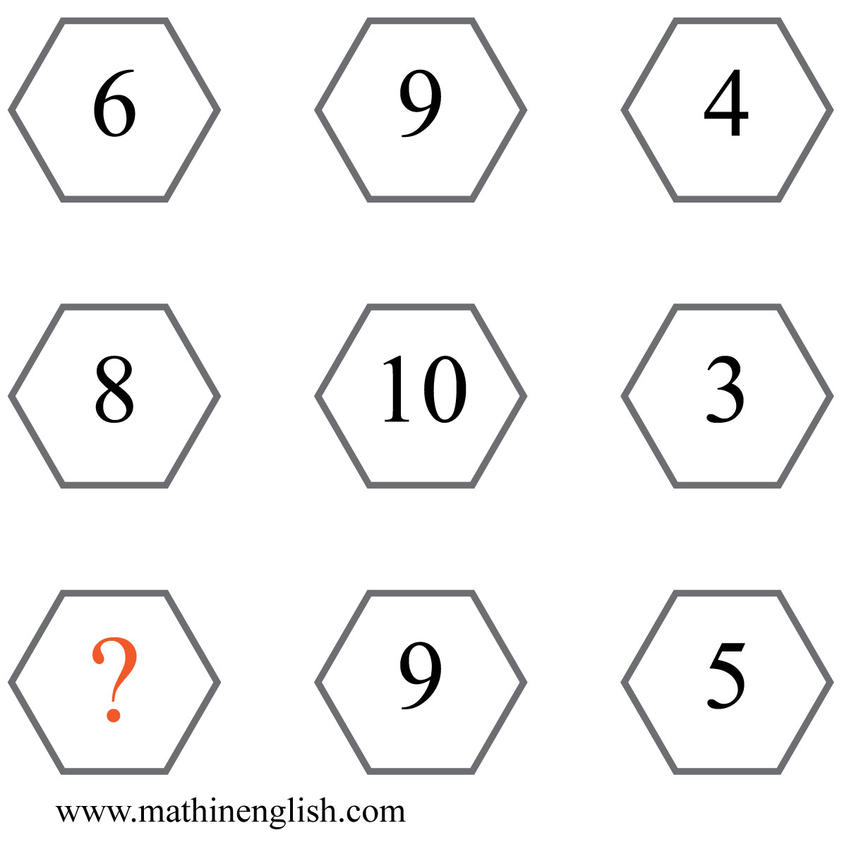
IQ Puzzle 3
Level 2A
What is the missing number?

Slide 5
IQ Puzzle 4
Level 2A
What number is needed here?

Slide 6
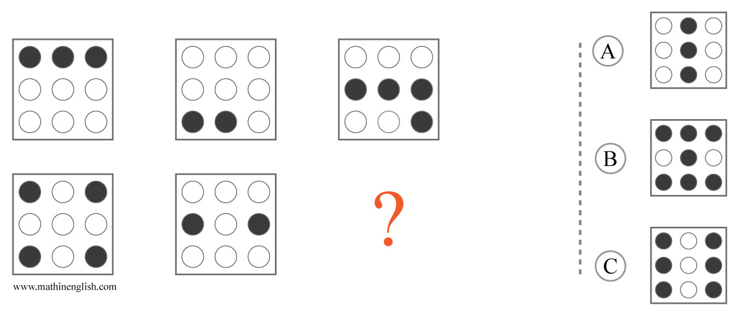
IQ Puzzle 5
Level 2A
Which option is correct?

Slide 7
IQ Puzzle 6
Level 2A
Which number is missing?

Slide 8
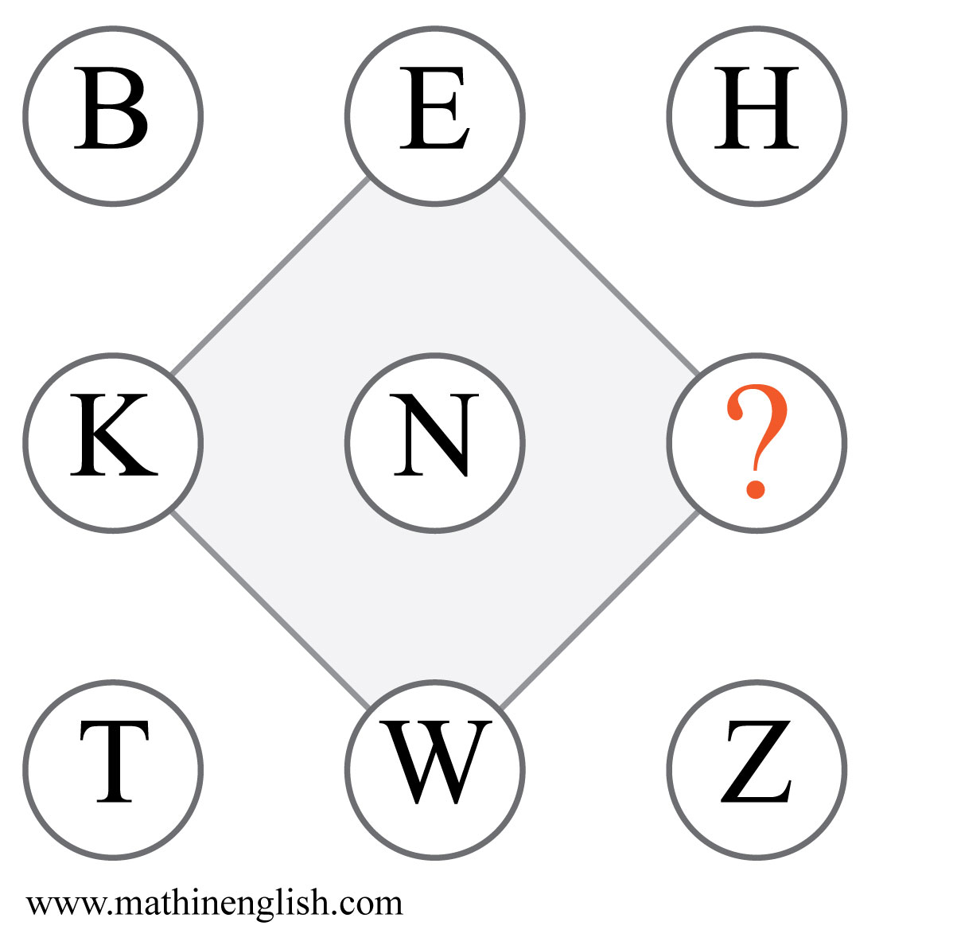
IQ Puzzle 7
Level 2A
Which letter is missing?

Slide 9
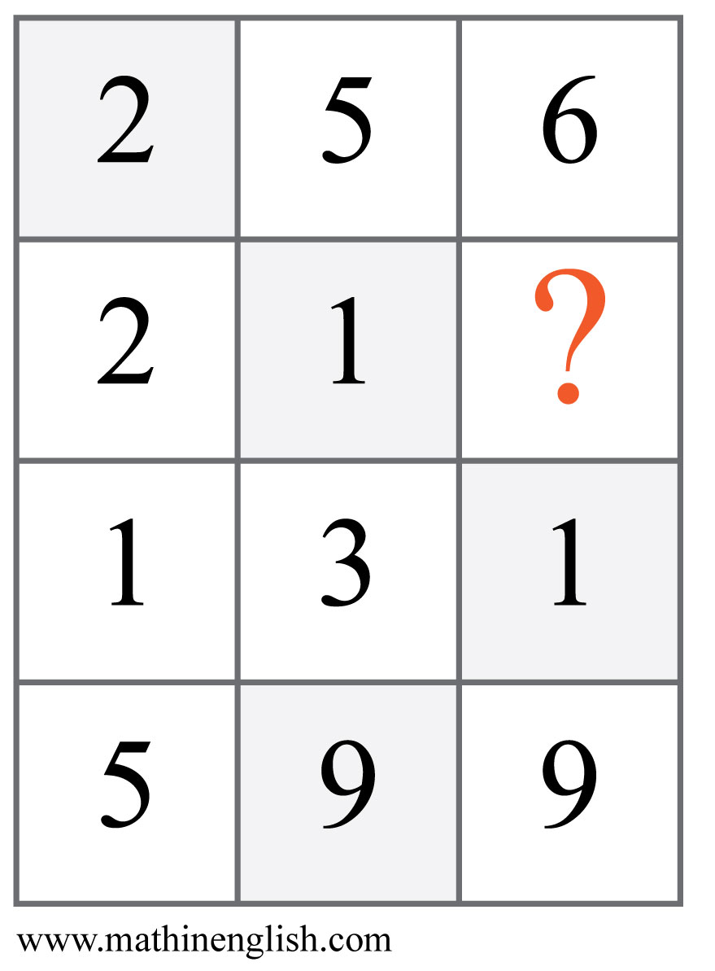
IQ Puzzle 8
Level 2A
Which number completes the pattern?

Slide 10
IQ Puzzle 9
Level 2A
Which time is missing?

Slide 11
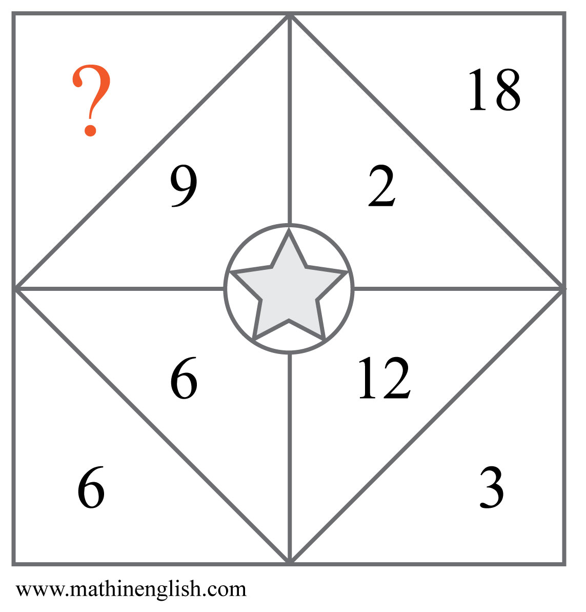
IQ Puzzle 10
Level 2A
Which number is missing?

Slide 12
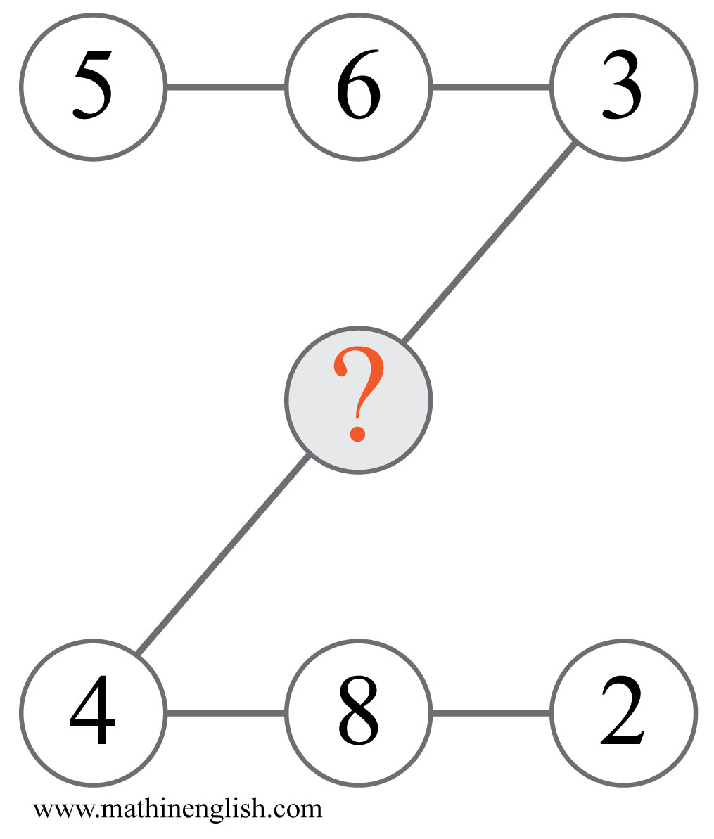
IQ Puzzle 11
Level 2A
Which number is missing?

Slide 13
IQ Puzzle 12
Level 2A
Which number is missing?

Slide 14
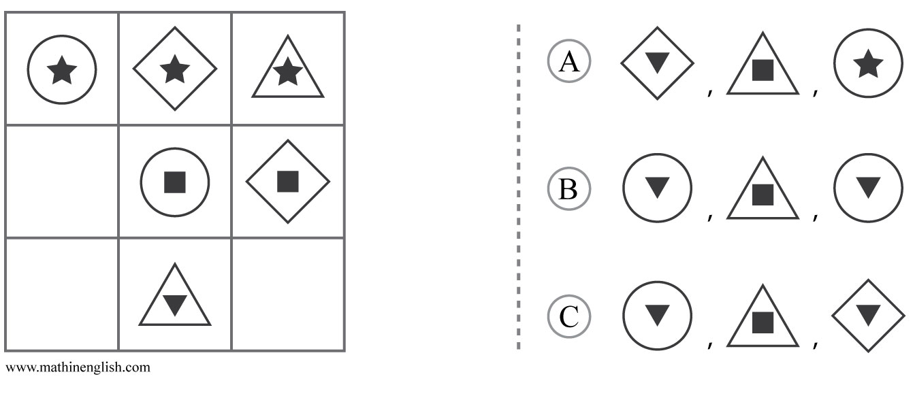
IQ Puzzle 13
Level 2A
Which option is correct?

Slide 15
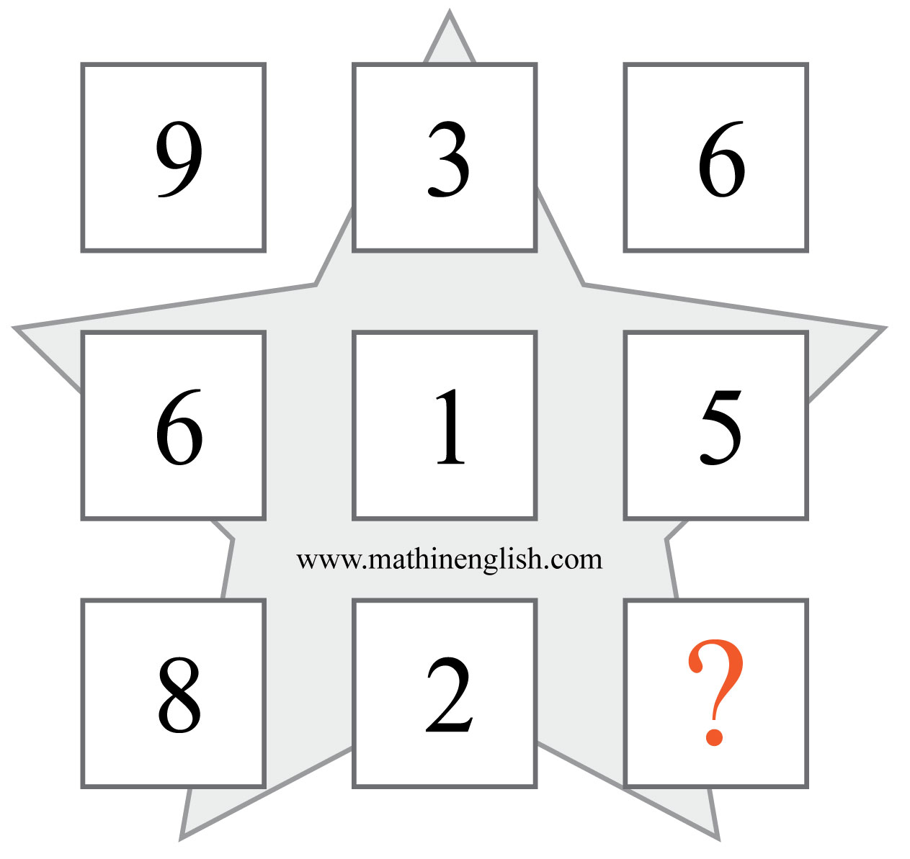
IQ Puzzle 14
Level 2A
What is the missing number?

Slide 16
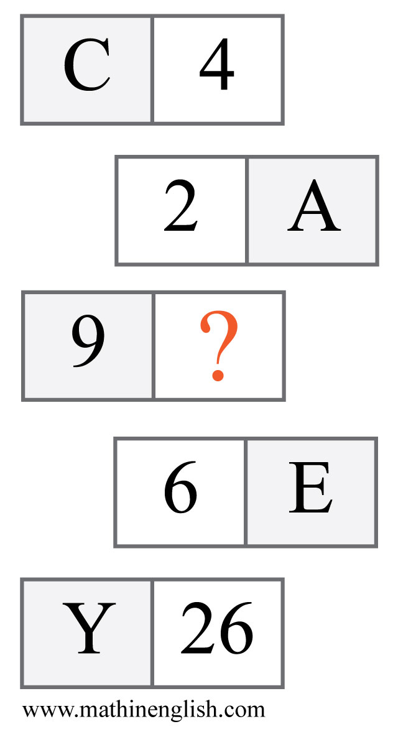
IQ Puzzle 15
Level 2A
Which letter is missing?

Slide 17
IQ Puzzle 16
Level 2A
Which number is missing?

Slide 18
IQ Puzzle 17
Level 2A
Which letter is missing?

Slide 19
IQ Puzzle 18
Level 2A
Which number is missing?

Slide 20
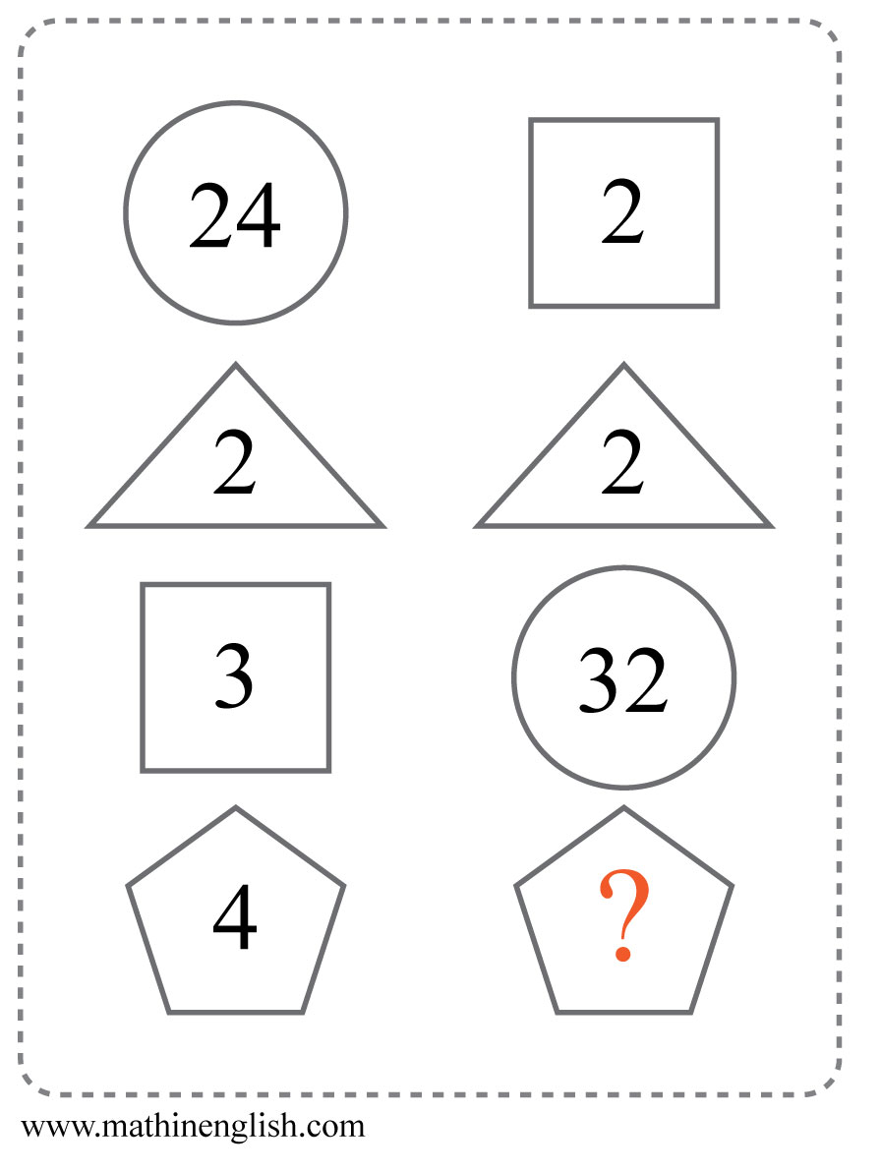
IQ Puzzle 19
Level 2A
Which numbers is missing?

Slide 21
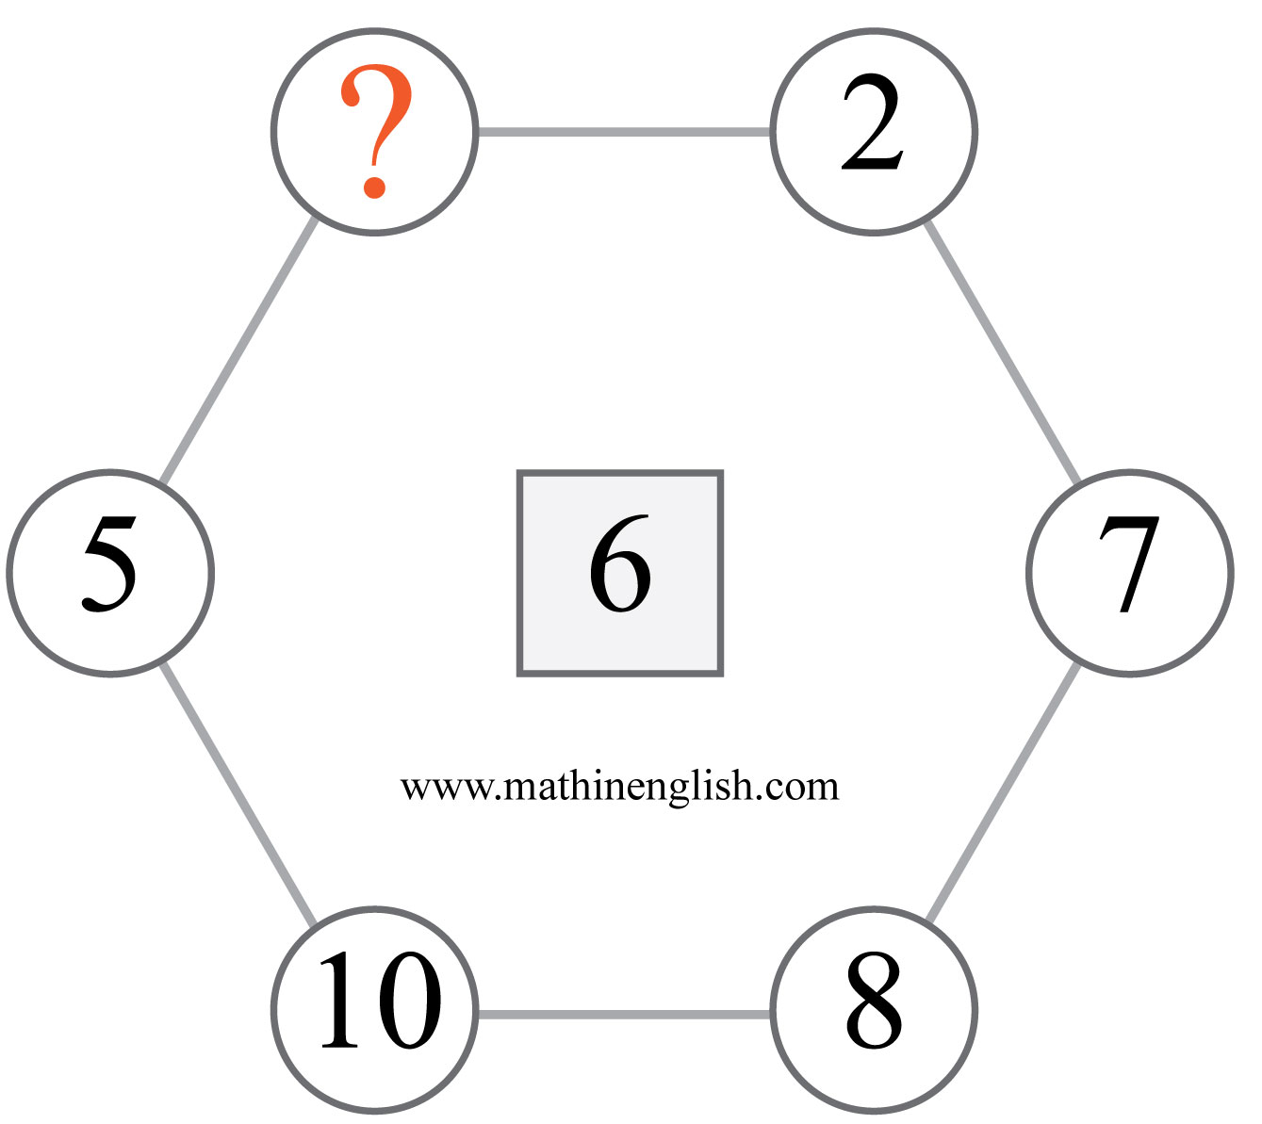
IQ Puzzle 20
Level 2A
Which number is missing?

Slide 22
Answers to puzzles 1 to 4
puzzle 1 : 4
The cell in te right bottom in each circle is the average of the other
3 cells in the circle.
puzzle 2 : 18
Multiply the 1 digit number by 2 to get the opposite number.
puzzle 3 : 6
In each row add up the right and left hexagon and then subtract 1
to get the middle one.
puzzle 4 : 4
The sum of the numbers in the 1st diamond is 10, the 2nd 11, 3rd 12,
and 4th diamond 13.
Copyright: www.mathinenglish.com
Level 2A

Slide 23
Answers to puzzles 5 to 8
puzzle 5 : A
The 3rd square in each row shows the dots that are not shaded
in the first 2 squares together.
puzzle 6 : 45
The 1st and 2nd cell add up to the 3rd, the 2nd and 3rd to the 4th,
4th and 5th to the 6th and so on.
puzzle 7 : Q
Increasing pattern of +3 in letter values.
puzzle 8 : 2
The first 3 numbers in each column add up to the 4th number.
Copyright: www.mathinenglish.com
Level 2A

Slide 24
Answers to puzzles 9 to 12
puzzle 9 : 2:43
Each watch shows a time that is 16 minutes later than the one
before.
puzzle 10 : 4
Each number pair multiplies to 36.
puzzle 11 : 7
Each row of numbers adds up to 14.
puzzle 12 : 3
The sum of the 3 numbers at the vertexes divided by 2.
Copyright: www.mathinenglish.com
Level 2A

Slide 25
Answers to puzzles 13 to 16
puzzle 13 : C
Each row contains a circle, diamond and triangle, filled with the same solid shape.
puzzle 14 : 6
Subtract the 2nd row from the 1st row to get the 3rd row.
puzzle 15 : H
The number is 1 more than the value of the letter number in
each row.
puzzle 16 : 10
The cells in the squares are following a + 2 pattern.
Copyright: www.mathinenglish.com
Level 2A

Slide 26
Answers to puzzles 17 to 20
puzzle 17 : F
The numbers around the star are multiples of 6 (=F).
puzzle 18 : 15
The sum of the vertical pairs in the 3rd oval is 24.
puzzle 19 : 8
The 1 digit numbers in each column multiply to the number in
the circle.
puzzle 20 : 4
The average of the opposite number pairs is 6.
Copyright: www.mathinenglish.com
Level 2A

