Slide 1

IQ puzzles and brain teasers
Level 1D

Slide 2
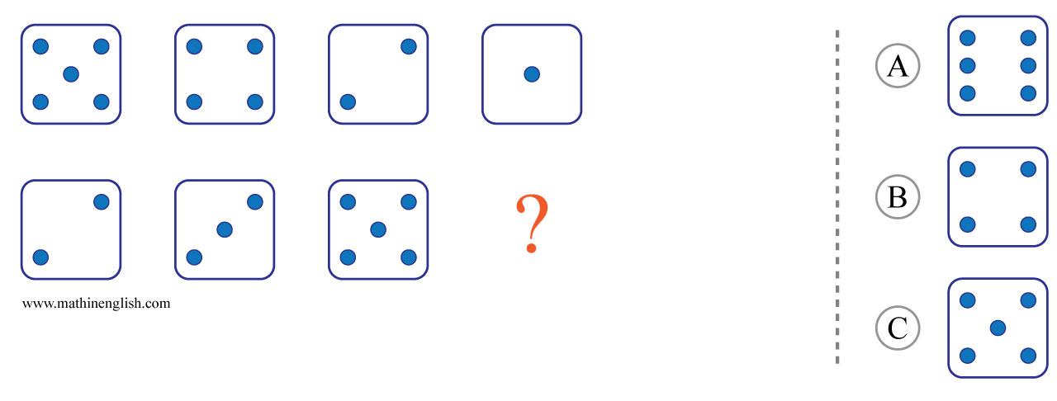



IQ Puzzle 1
Level 1D
Which option is correct?

Slide 3
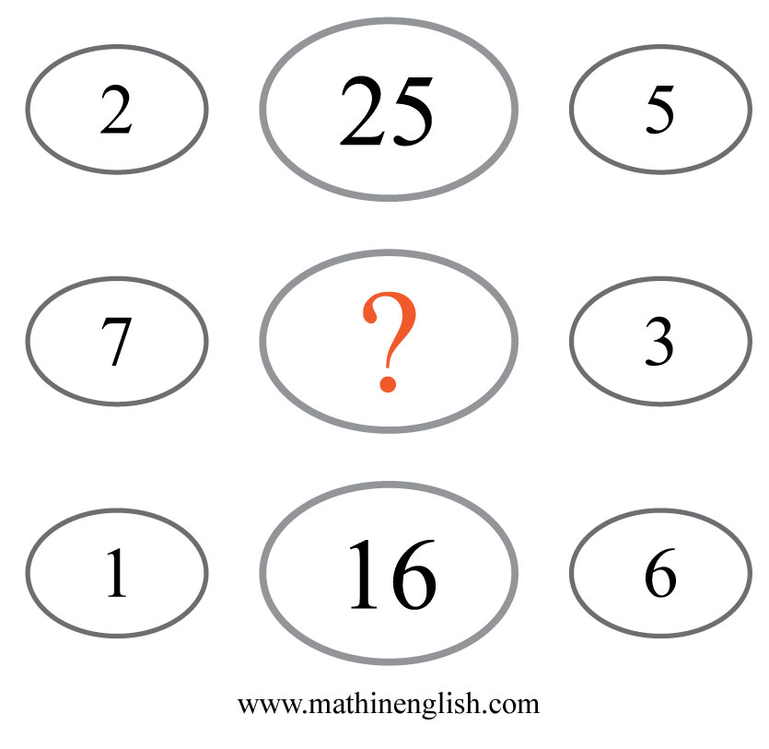
IQ Puzzle 2
Level 1D
Which number is missing?

Slide 4
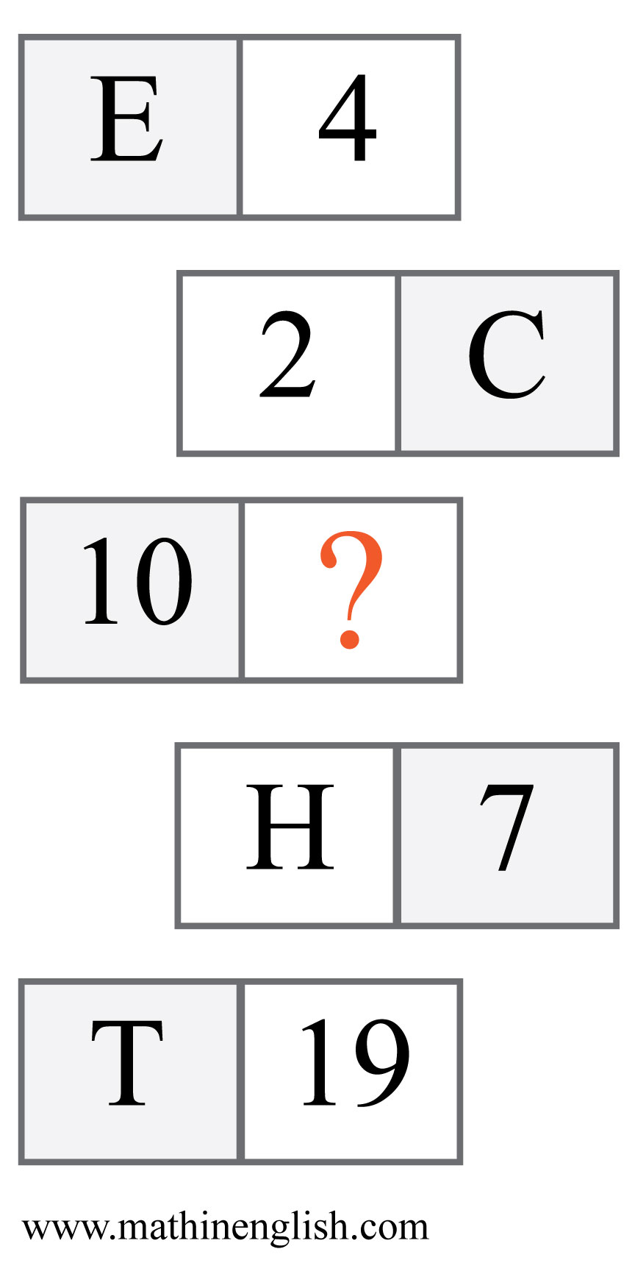
IQ Puzzle 3
Level 1D
What is the missing number?

Slide 5
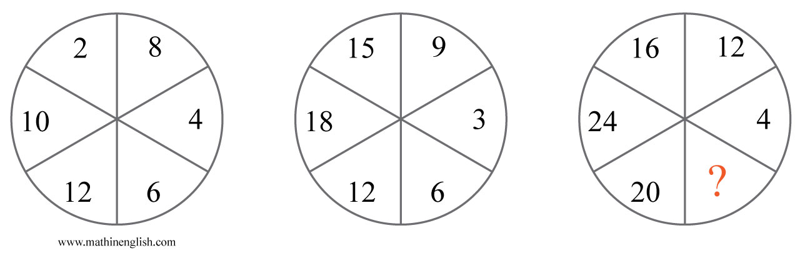
IQ Puzzle 4
Level 1D
What number is needed here?

Slide 6
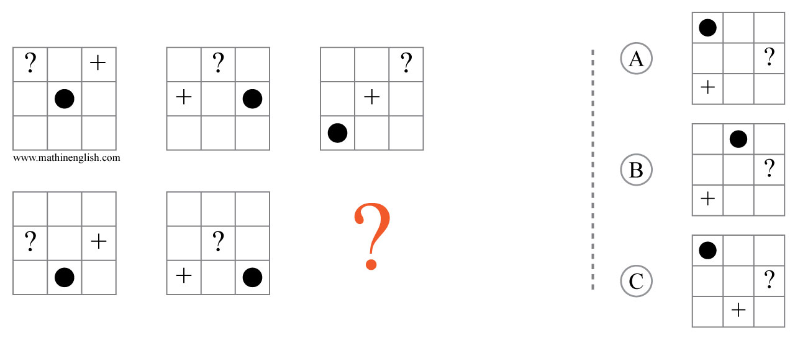
IQ Puzzle 5
Level 1D
Which option is correct?

Slide 7
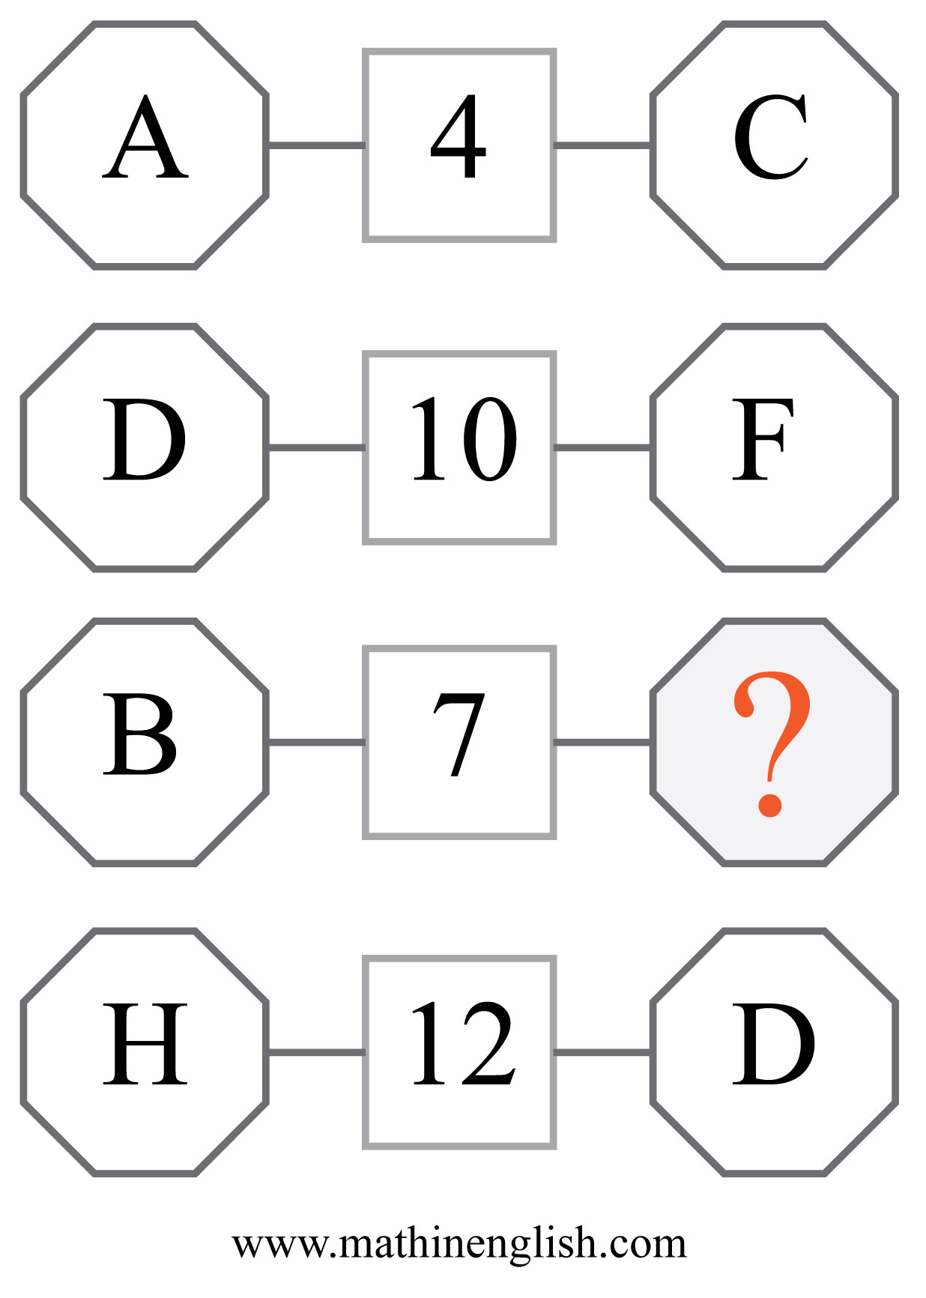
IQ Puzzle 6
Level 1D
Which letter is missing?

Slide 8
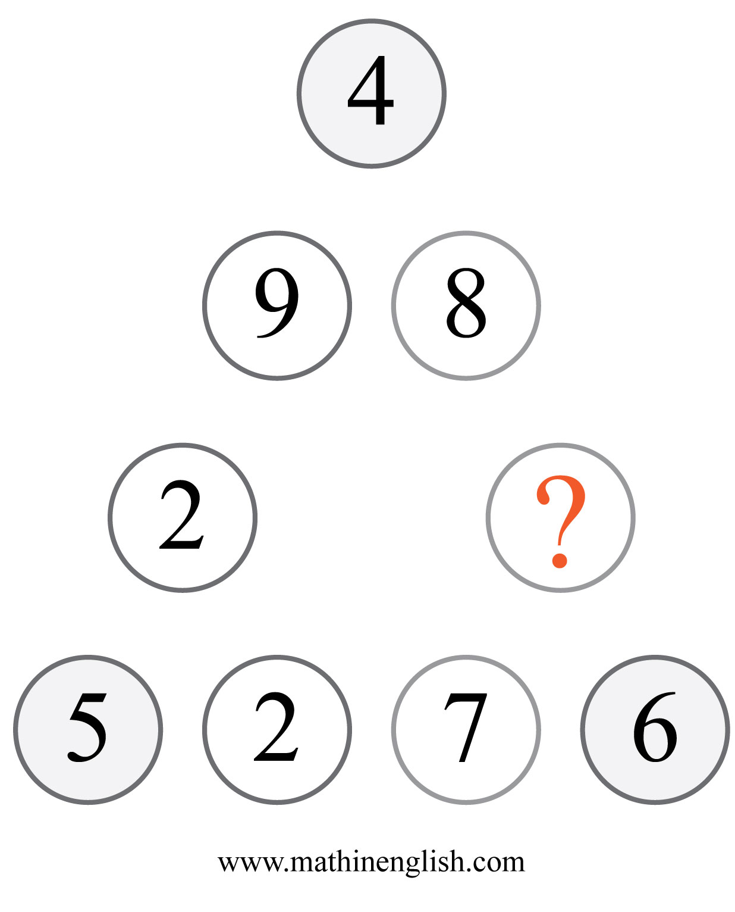
IQ Puzzle 7
Level 1D
Which number is missing?

Slide 9
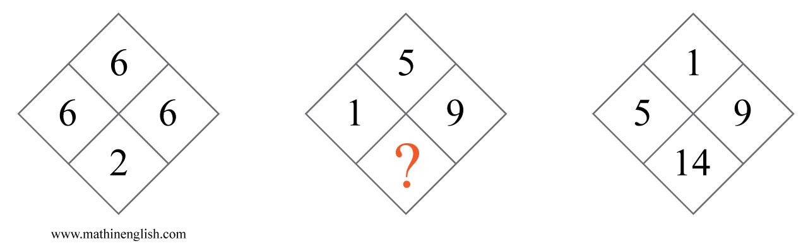
IQ Puzzle 8
Level 1D
Which number completes the pattern?

Slide 10
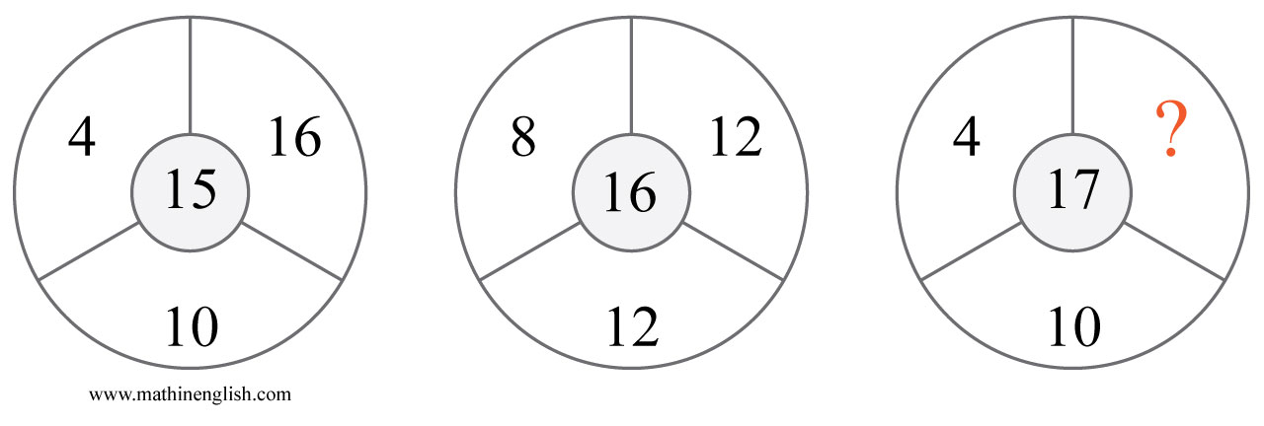
IQ Puzzle 9
Level 1D
Which number is missing?

Slide 11
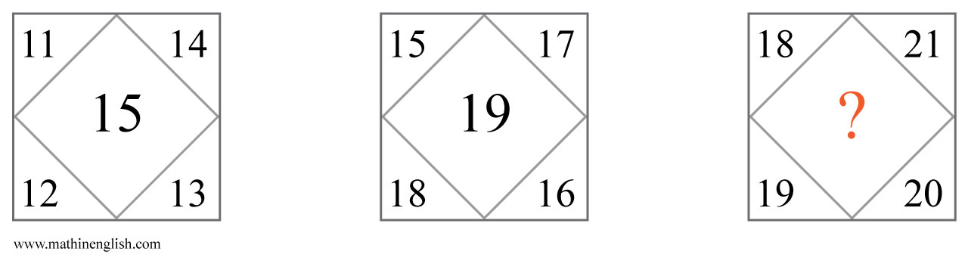
IQ Puzzle 10
Level 1D
Which number is missing?

Slide 12
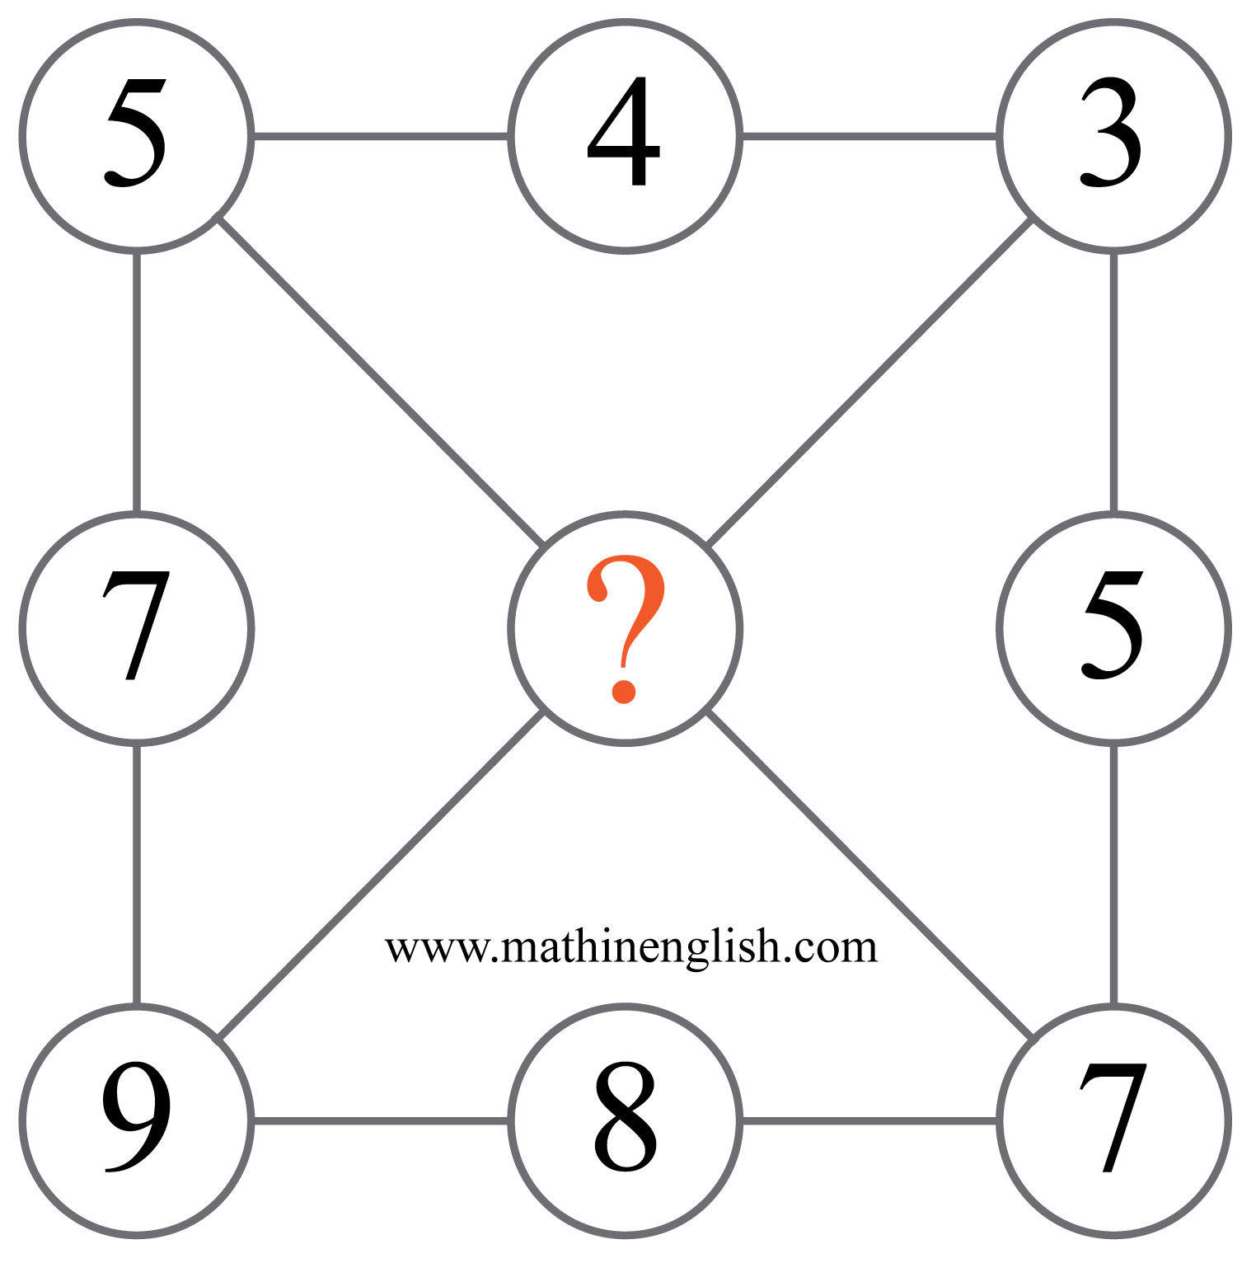
IQ Puzzle 11
Level 1D
Which number is missing?

Slide 13
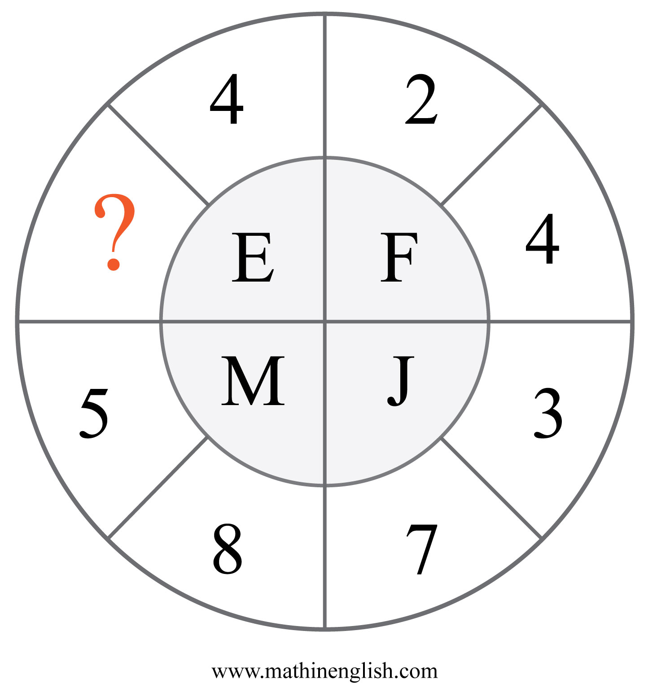
IQ Puzzle 12
Level 1D
Which number is missing?

Slide 14
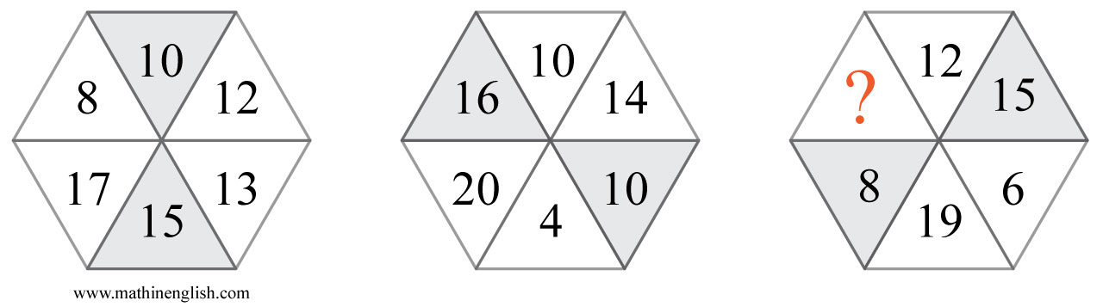
IQ Puzzle 13
Level 1D
Which number is missing ?

Slide 15
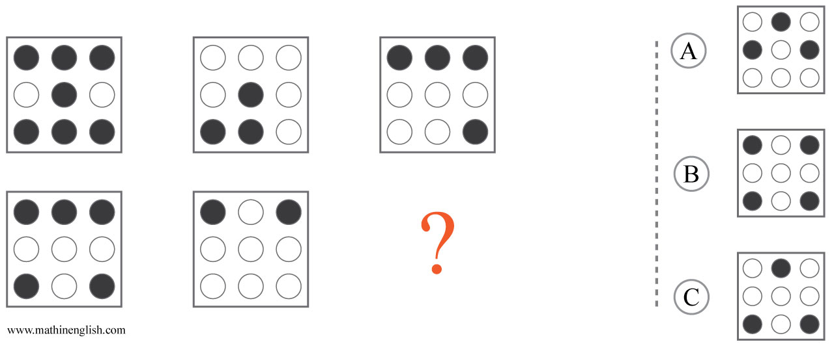
IQ Puzzle 14
Level 1D
What is the correct option?

Slide 16
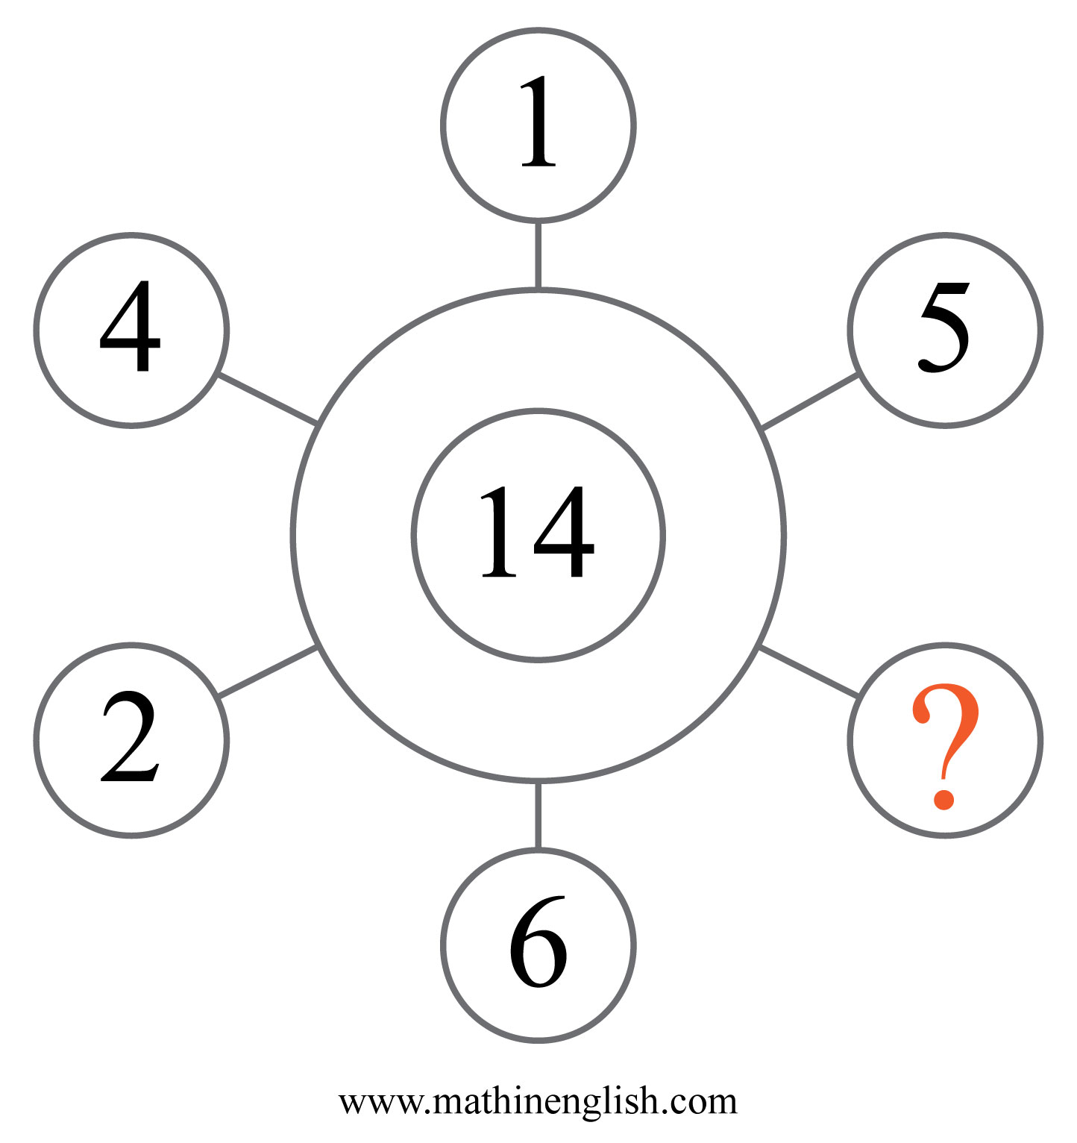
IQ Puzzle 15
Level 1D
Which number is missing?

Slide 17
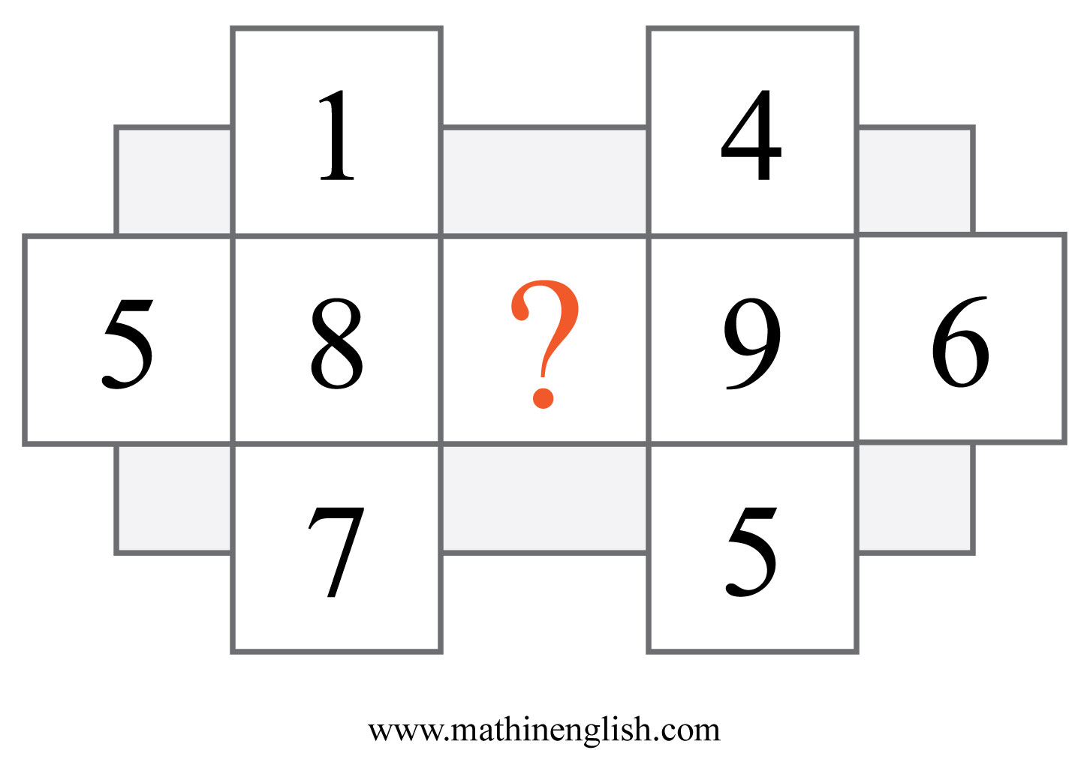
IQ Puzzle 16
Level 1D
Which number is missing?

Slide 18
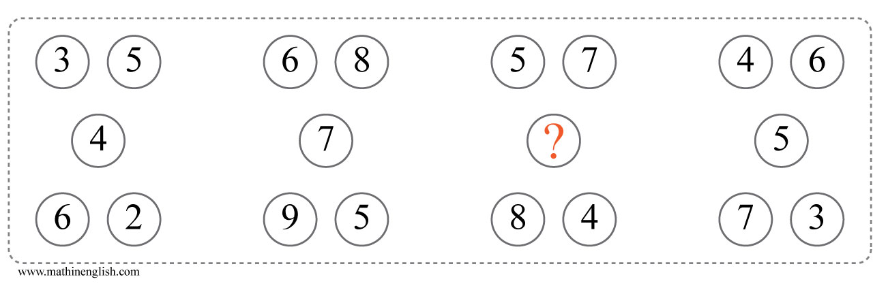
IQ Puzzle 17
Level 1D
Which number is missing?

Slide 19
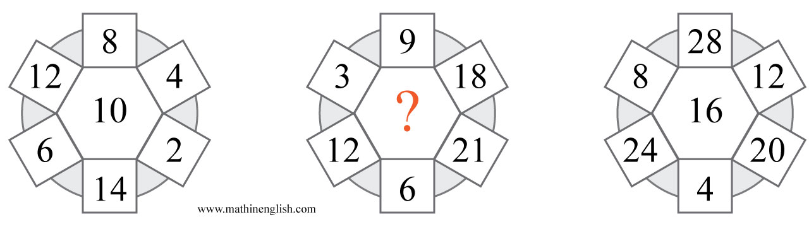
IQ Puzzle 18
Level 1D
Which number is missing?

Slide 20
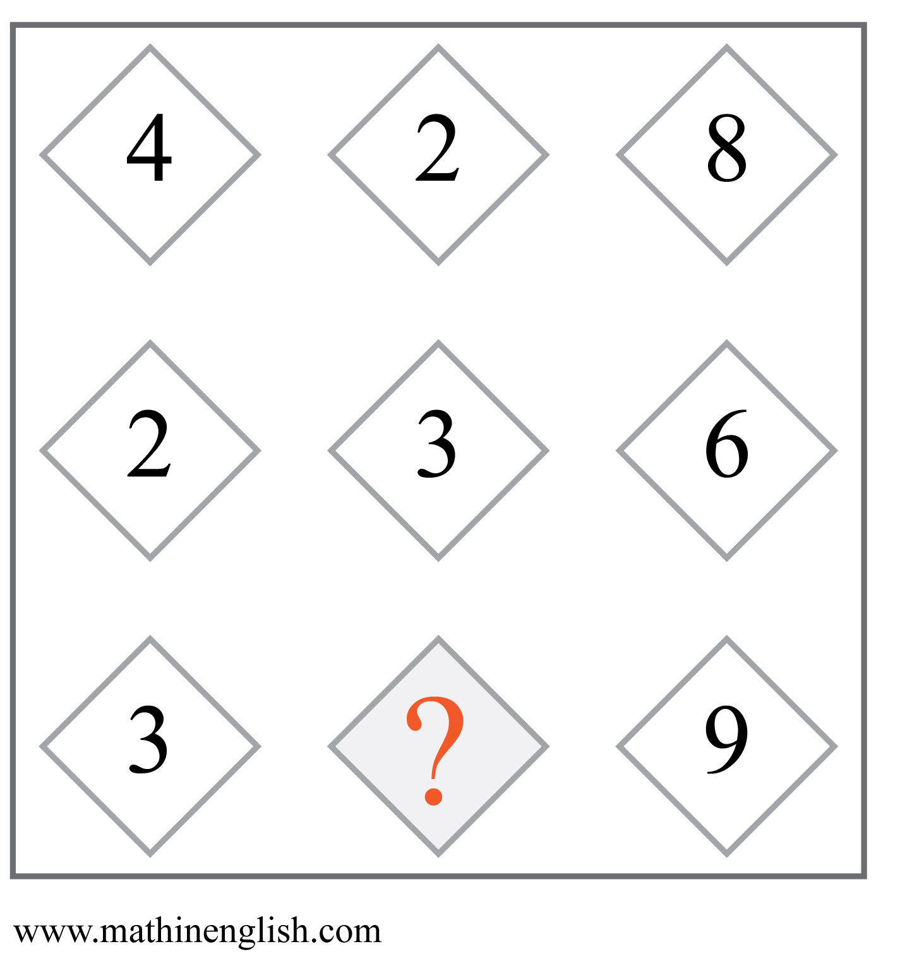
IQ Puzzle 19
Level 1D
Which numbers is missing?

Slide 21
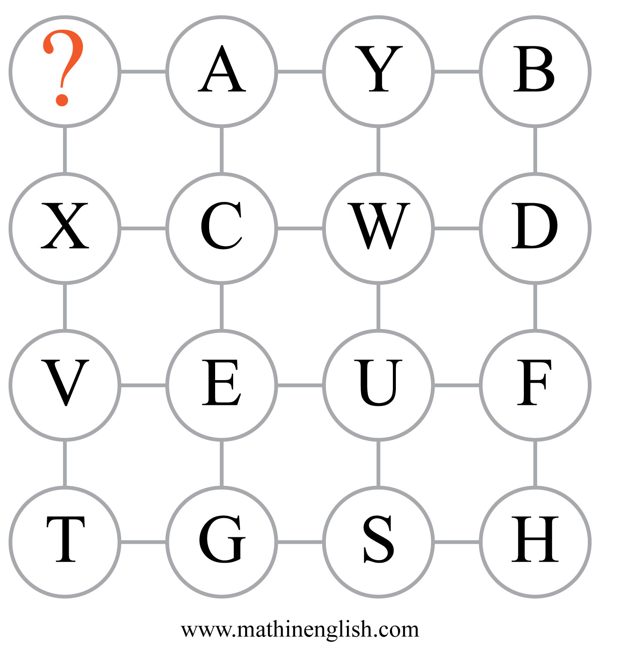
IQ Puzzle 20
Level 1D
Which letter is missing?

Slide 22
Answers to puzzles 1 to 4
puzzle 1 : A
Each top-down dice pair adds up to 7.
puzzle 2 : 73
The left and right numbers form the 2 digits of 73.
puzzle 3 : K
Add a 1 to the numbers to get the letter value in the rows.
puzzle 4 : 8
8 is a multiple of 4. The circles follow the multiples of 2, 3 and 4
Copyright: www.mathinenglish.com
Level 1D

Slide 23
Answers to puzzles 5 to 8
puzzle 5 : C
The symbols moves 1 cell to the right in the next square.
puzzle 6 : E
B and E add up to 7.
puzzle 7 : 2
The cells of each side of the triangle add up to 20.
puzzle 8 : 2
The sum of the horizontal cells in each diamond is equal to the product
of the top and bottom numbers.
Copyright: www.mathinenglish.com
Level 1D

Slide 24
Answers to puzzles 9 to 12
puzzle 9 : 20
The sum of the 3 outer numbers is 34, and divided by 2, will give
the value of the core number .
puzzle 10 : 22
22 completes the 18 to 22 range.
puzzle 11 : 6
The average of 5 and 7 is 6.
puzzle 12 : 1
1 and 4 add up to 5, the value of the letter number E.
Copyright: www.mathinenglish.com
Level 1D

Slide 25
Answers to puzzles 13 to 16
puzzle 13 : 13
The difference between the opposite numbers is 7. The shapes
follow a 5, 6 , 7 difference pattern.
puzzle 14 : C
The 3rd square is formed by subtracting the shaded dots of the
2nd square from the 1st.
puzzle 15 : 3
3 and the opposite 4 make 7. Multiply by 2 to give the middle
number.
puzzle 16 : 3
3 and 5 add up to the 8 in the middle and 3 and 6 to 9.
Copyright: www.mathinenglish.com
Level 1D

Slide 26
Answers to puzzles 17 to 20
puzzle 17 : 6
6 completes the 4 to 8 range.
puzzle 18 : 15
15 is the missing multiple of 3.
puzzle 19 : 3
3 times 3 is 9. In each row the 3rd number is the product of the
first 2 numbers.
puzzle 20 : Z
There are 2 sequences, one up and one decreasing. The first cell is Z
and every other 2nd cell are part of the decreasing pattern.
Copyright: www.mathinenglish.com
Level 1D

