Slide 1
IQ puzzles and brain teasers
Level 1C

Slide 2
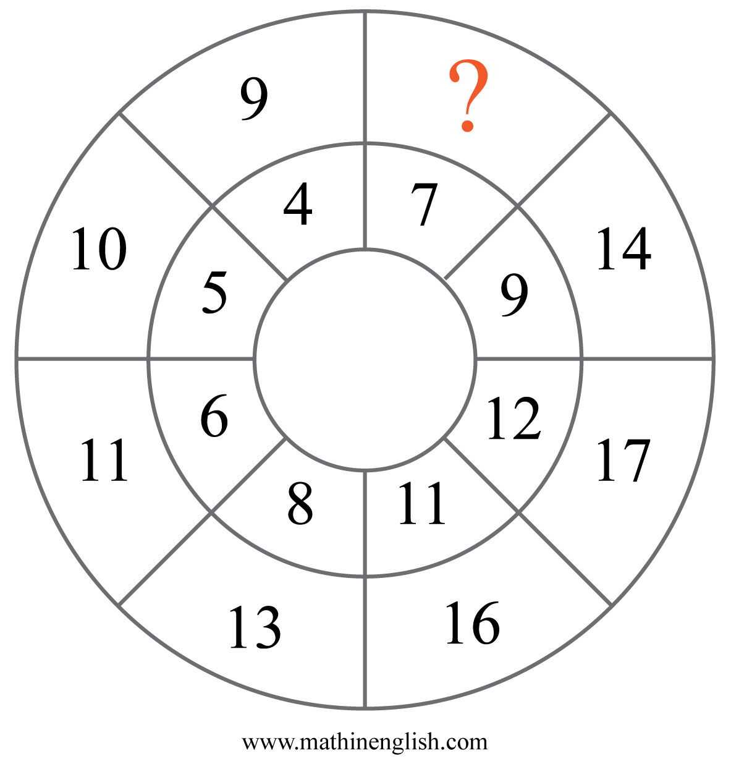
IQ Puzzle 1
Level 1C
Which number is missing?

Slide 3
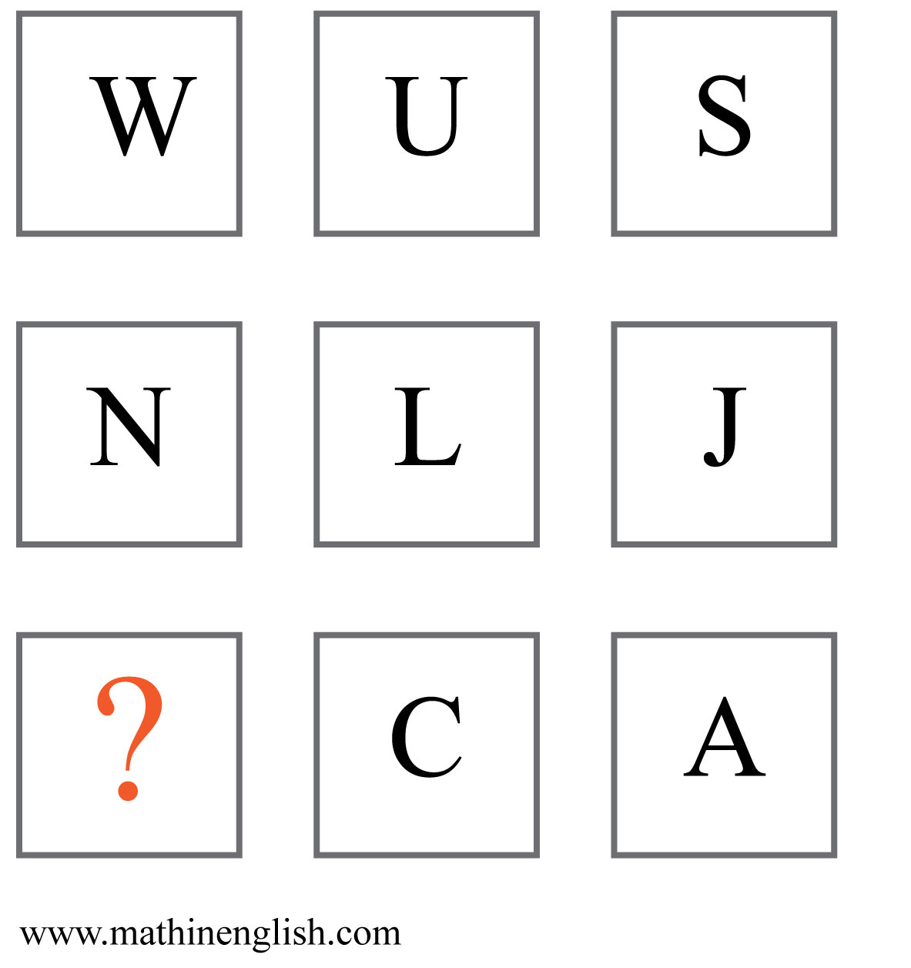
IQ Puzzle 2
Level 1C
Which letter is missing?

Slide 4
IQ Puzzle 3
Level 1C
What is the missing number?

Slide 5
IQ Puzzle 4
Level 1C
What number is needed here?

Slide 6
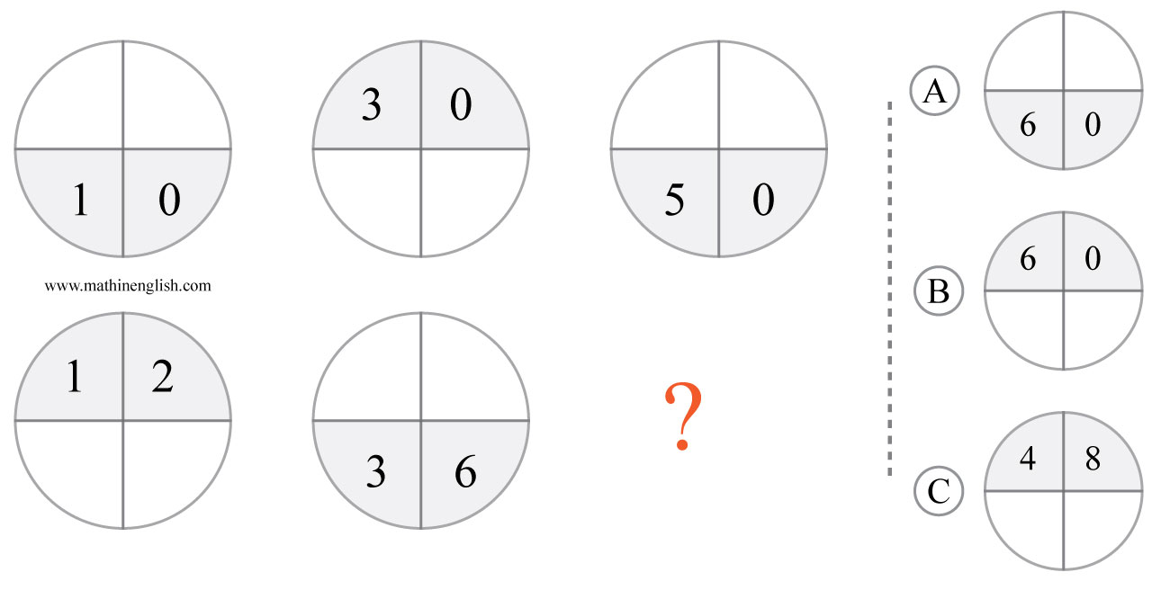
IQ Puzzle 5
Level 1C
Which option is correct ?

Slide 7
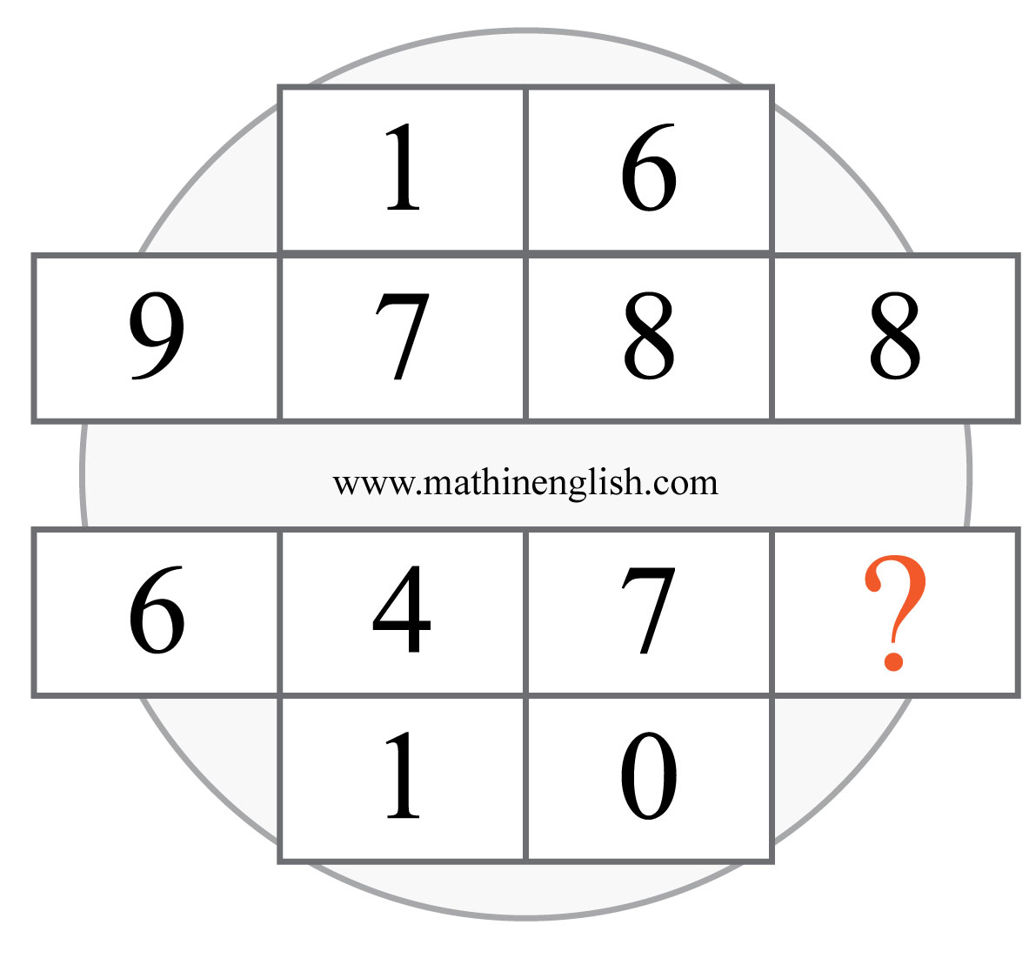
IQ Puzzle 6
Level 1C
Which number is missing?

Slide 8
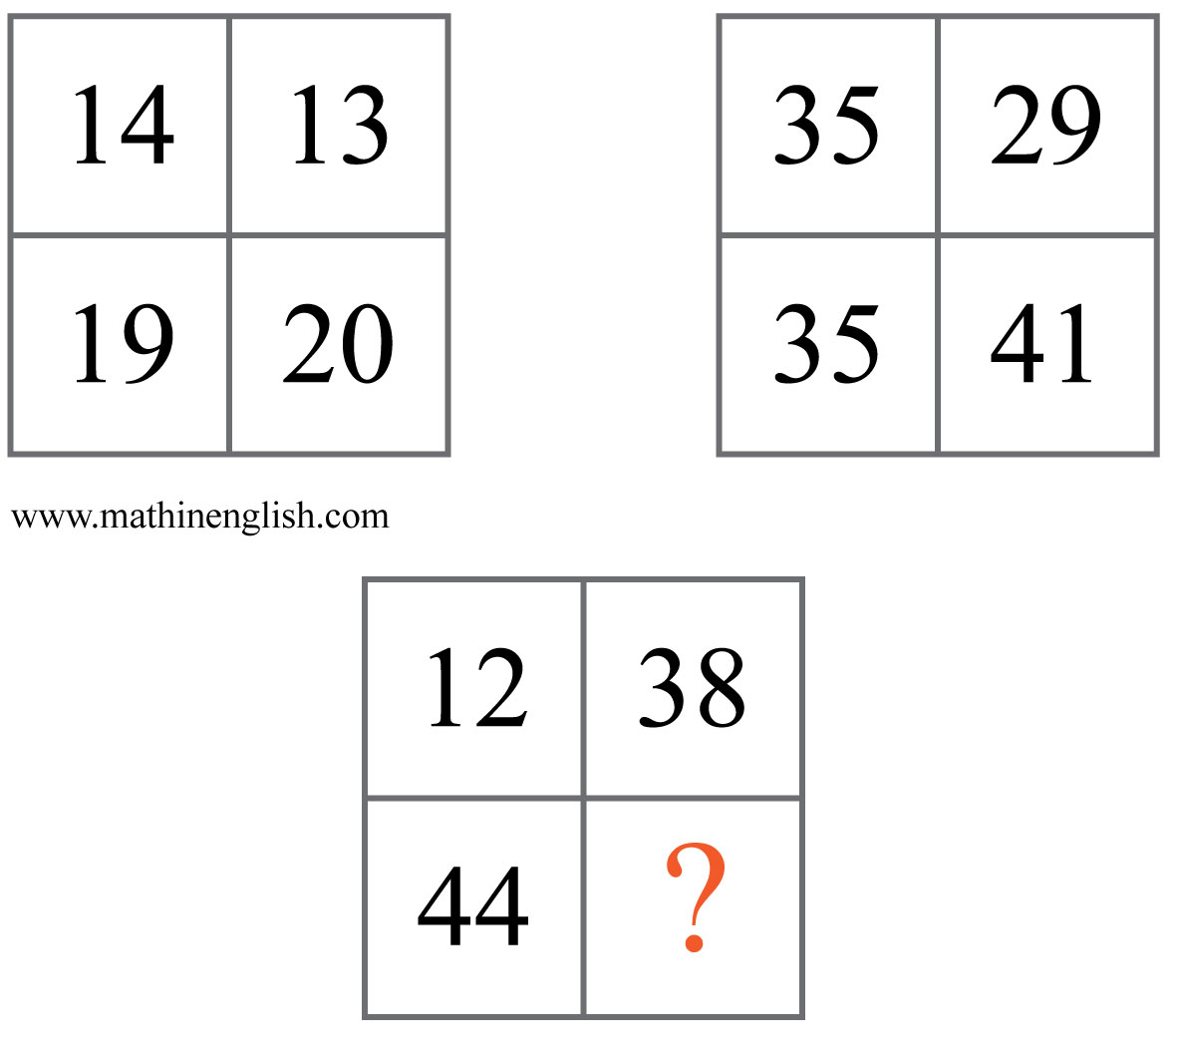
IQ Puzzle 7
Level 1C
Which number is missing?

Slide 9
IQ Puzzle 8
Level 1C
Which number completes the pattern?

Slide 10
IQ Puzzle 9
Level 1C
Which number is missing?

Slide 11
IQ Puzzle 10
Level 1C
Which number is missing?

Slide 12
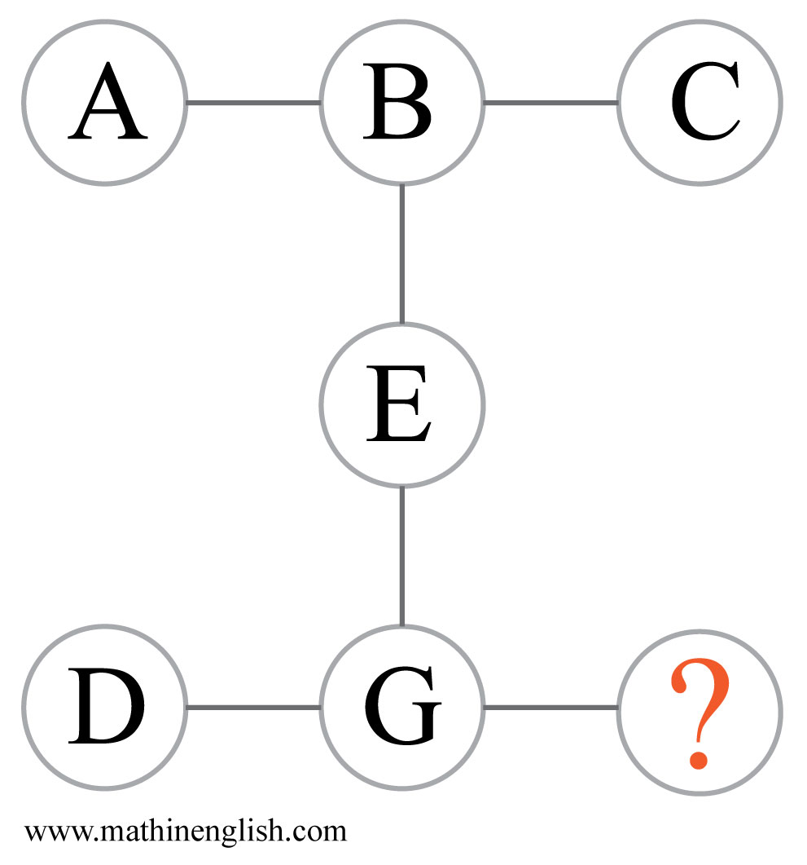
IQ Puzzle 11
Level 1C
Which letter is missing?

Slide 13
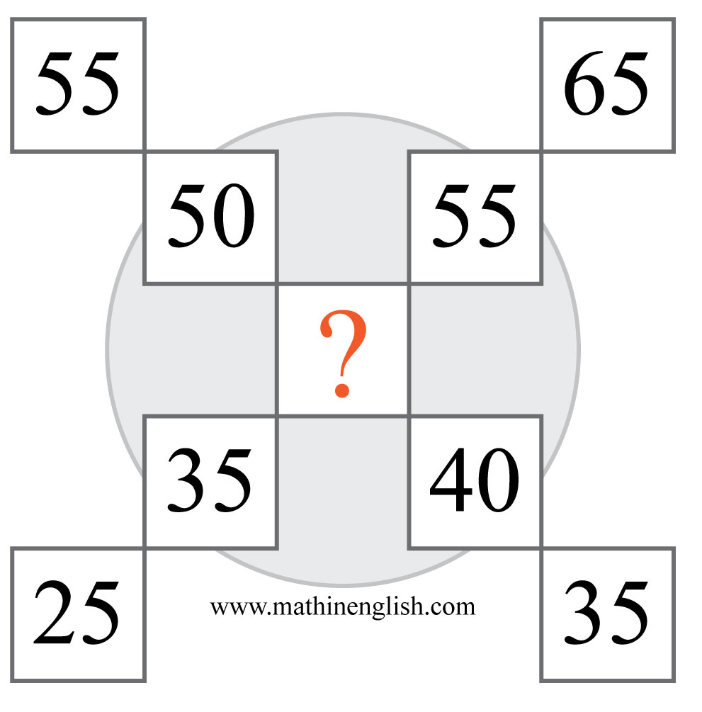
IQ Puzzle 12
Level 1C
Which number is missing?

Slide 14
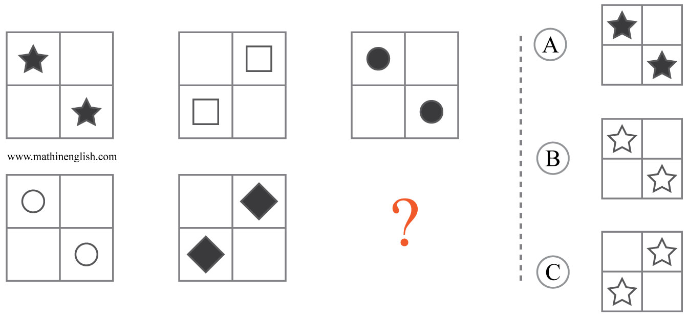
IQ Puzzle 13
Level 1C
What is the correct option ?

Slide 15
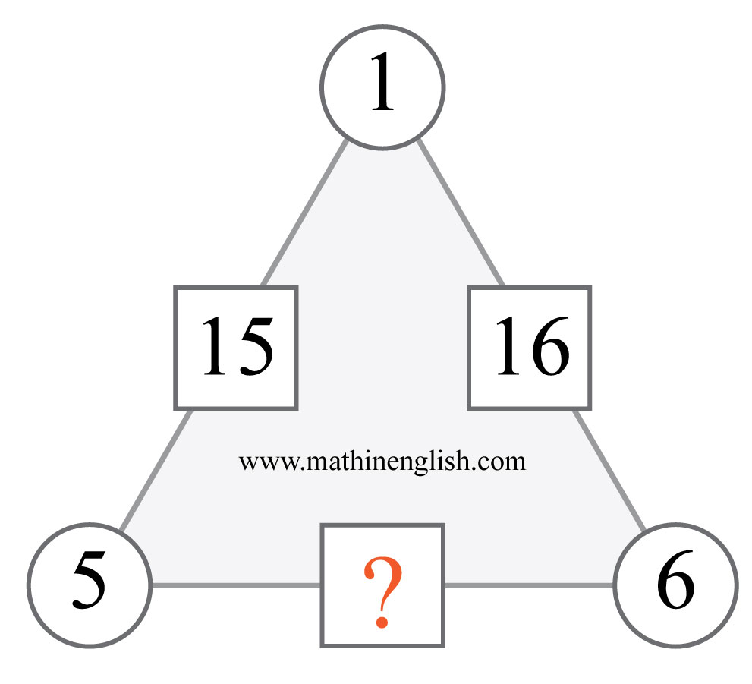
IQ Puzzle 14
Level 1C
What is the missing number?

Slide 16
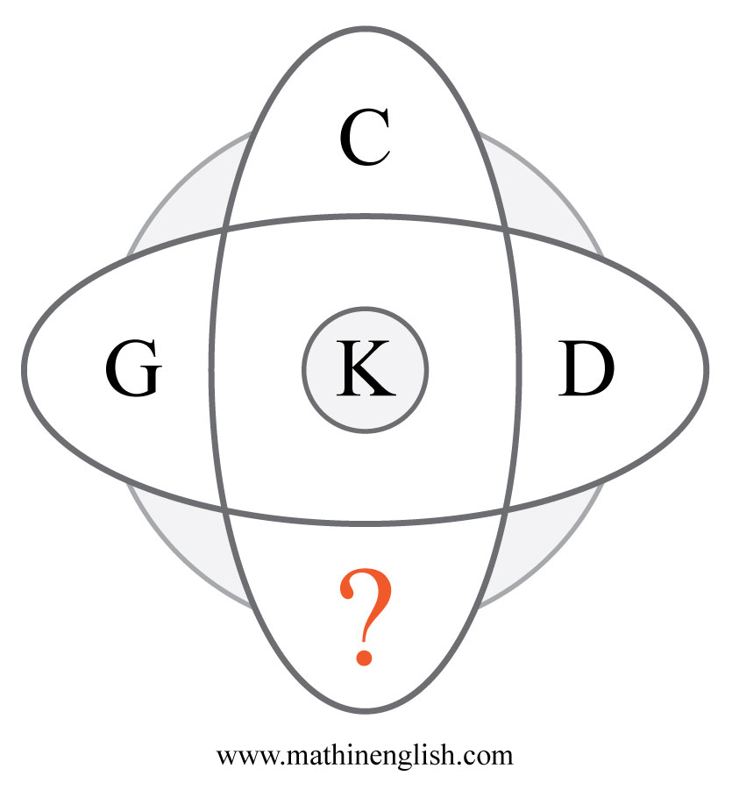
IQ Puzzle 15
Level 1C
Which letter is missing?

Slide 17
IQ Puzzle 16
Level 1C
Which number is missing?

Slide 18
IQ Puzzle 17
Level 1C
Which letter is missing?

Slide 19
IQ Puzzle 18
Level 1C
Which number is missing?

Slide 20
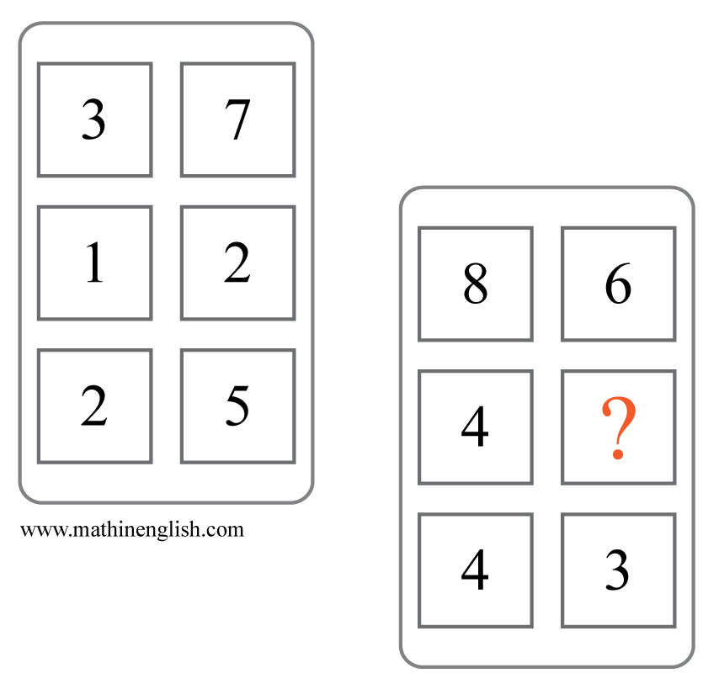
IQ Puzzle 19
Level 1C
Which number is missing?

Slide 21
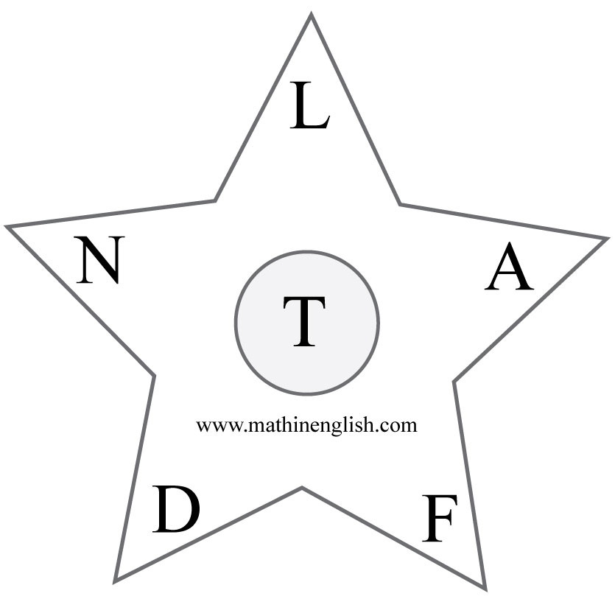
IQ Puzzle 20
Level 1C
Which letter is the odd one out?

Slide 22
Answers to puzzles 1 to 4
puzzle 1 : 12
The difference between 12 and 7 is 5, just as with all the other
combinations in the circle.
puzzle 2 : E
Each row follows a decreasing pattern by 2. E minus 2 is a C.
puzzle 3 : 10
Multiply the number of sides of each shape by 2.
puzzle 4 : 34
The cell above 2 cells is the average of these 2 cells.
Copyright: www.mathinenglish.com
Level 1C

Slide 23
Answers to puzzles 5 to 8
puzzle 5 : B
The shaded areas of the circles alternate and the numbers have a 1 : 3 : 5 ratio.
puzzle 6 : 3
The cells in the top rows add up to 16. The cells in the 2 lower
rows to 10.
puzzle 7 : 18
The sum of the 2 right cells in each square are equal to the sum
of the cells on the left.
puzzle 8 : 2 and 21
Similar to the Fibonacci sequence.
Copyright: www.mathinenglish.com
Level 1C

Slide 24
Answers to puzzles 9 to 12
puzzle 9 : 10
All numbers in the star add up to 50.
puzzle 10 : 26
Fill in 26 and calculate.
puzzle 11 : K
D plus G equal 11, or K.
puzzle 12 : 45
The middle cell is part of 2 patterns.Upwards + 10 and downwards -5.
Copyright: www.mathinenglish.com
Level 1C

Slide 25
Answers to puzzles 13 to 16
puzzle 13 : B
Reflect the shapes in the next square and alternate between shaded
and non-shaded.
puzzle 14 : 56
The digits 5 and 6 of 56 are the 2 cells on its left and right.
puzzle 15 : H
C and H, and the pair G and D add up to 11, or K.
puzzle 16 : 20
Multiply 2 by 2 by 5.
Copyright: www.mathinenglish.com
Level 1C

Slide 26
Answers to puzzles 17 to 20
puzzle 17 : A
The average of the letter numbers of A and G is 4.
puzzle 18 : 20
20 divided by 4 equals 5. Triangle pointing up multiply, triangle
pointing down divide.
puzzle 19 : 3
Basic subtraction. 86 minus 43 equals 43.
puzzle 20 : A
A is the only vowel..
Copyright: www.mathinenglish.com
Level 1C

