Slide 1
IQ puzzles and brain teasers
Level 1A

Slide 2
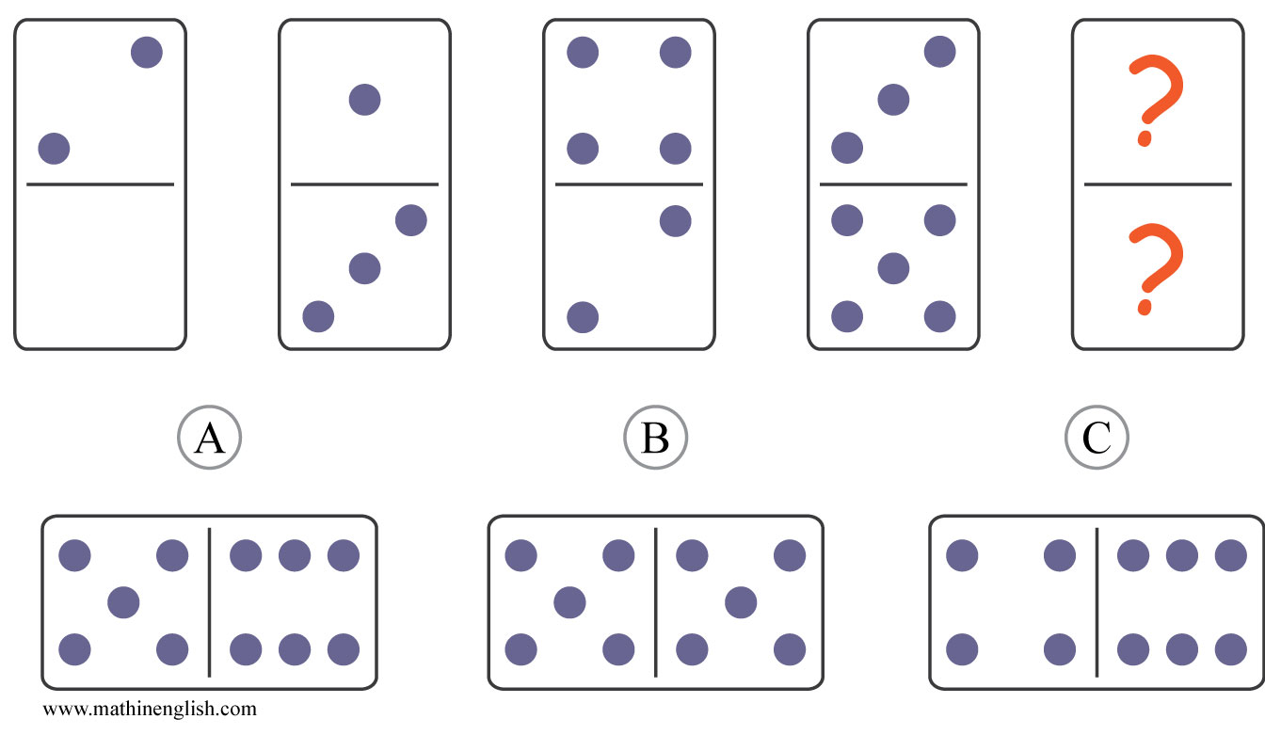
IQ Puzzle 1
Level 1A
Which domino completes this row ?

Slide 3
IQ Puzzle 2
Level 1A
Which number completes the sequence ?

Slide 4
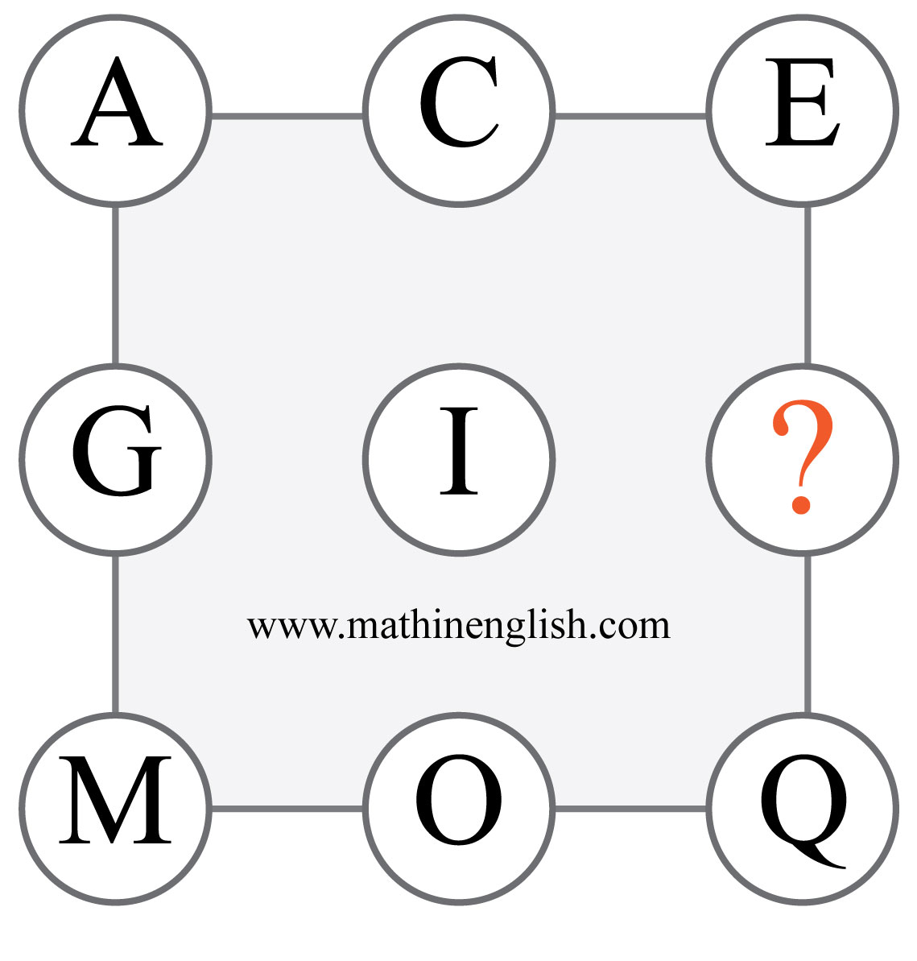
IQ Puzzle 3
Level 1A
What is the missing letter in the sequence ?

Slide 5
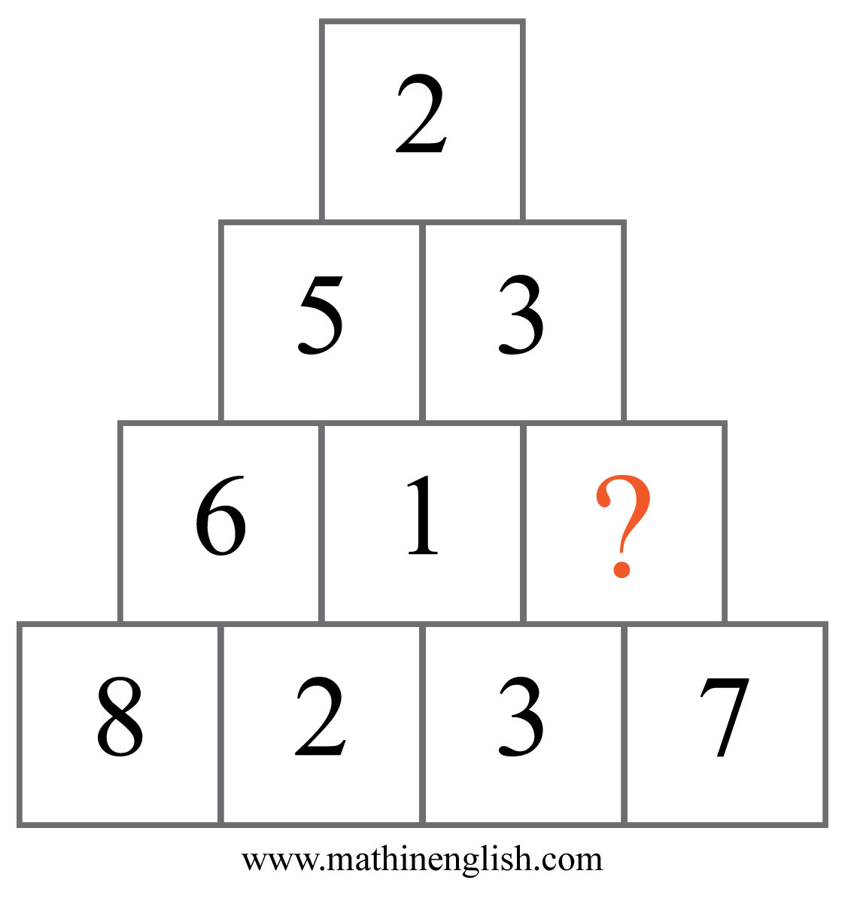
IQ Puzzle 4
Level 1A
What number is needed here?

Slide 6
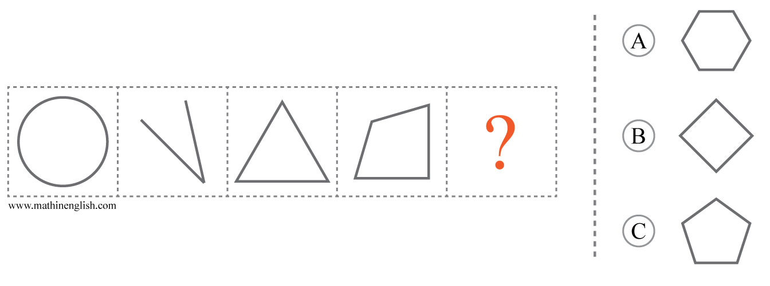
IQ Puzzle 5
Level 1A
Which option is correct?

Slide 7
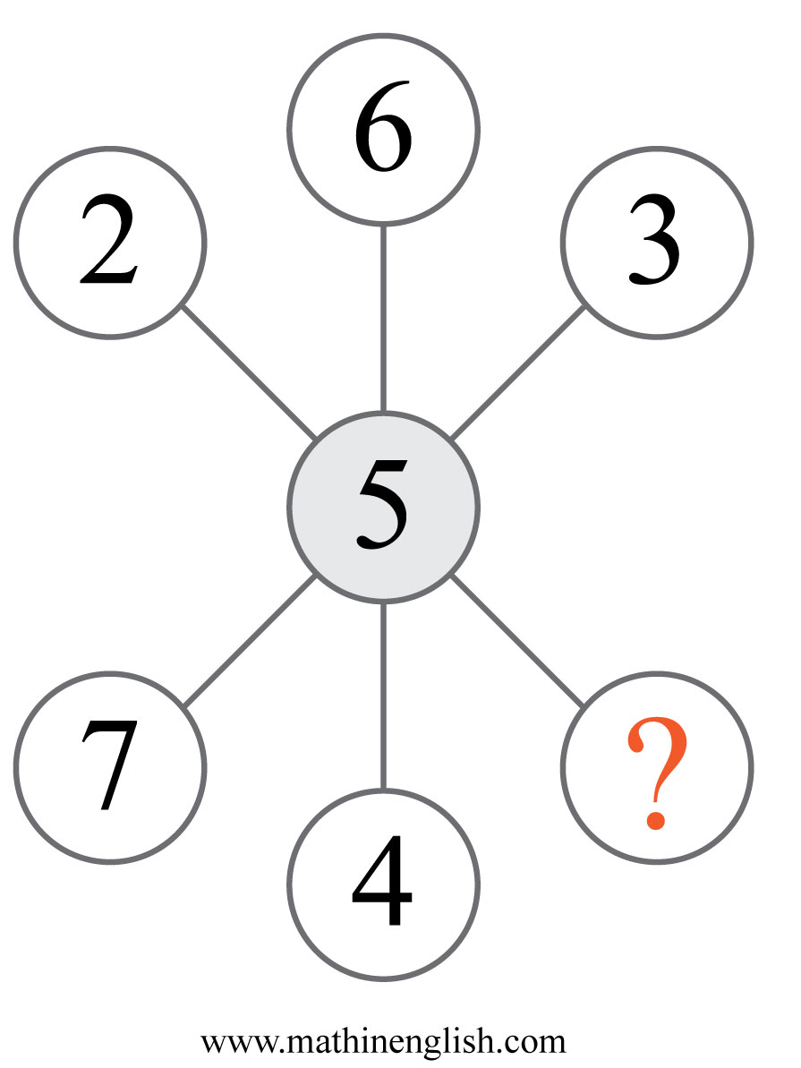
IQ Puzzle 6
Level 1A
Which number is missing?

Slide 8
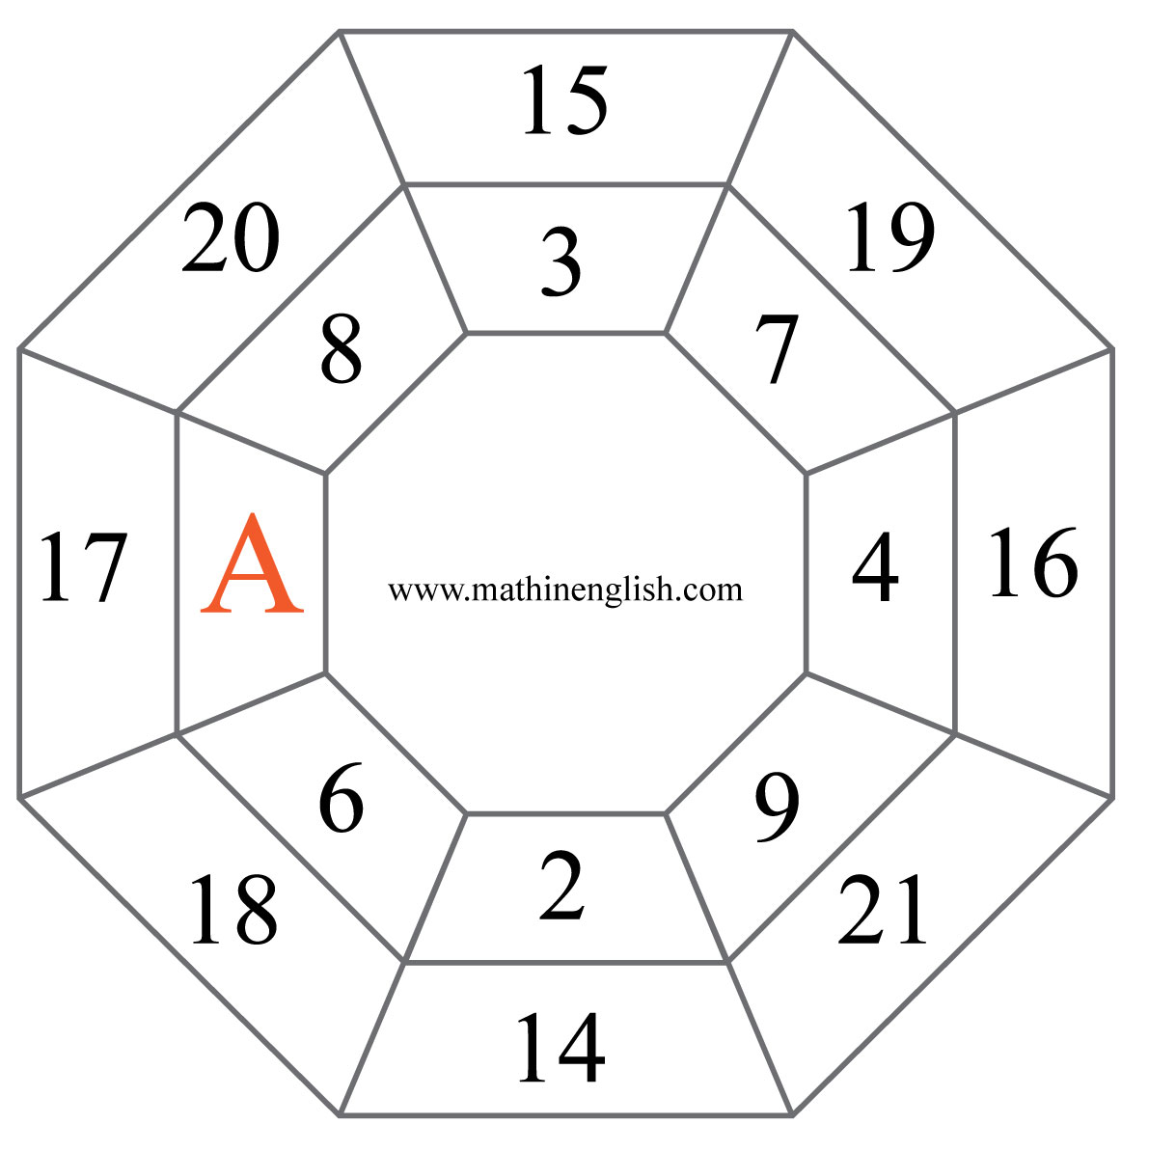
IQ Puzzle 7
Level 1A
What is the value of A ?

Slide 9
IQ Puzzle 8
Level 1A
Which number completes the pattern?

Slide 10
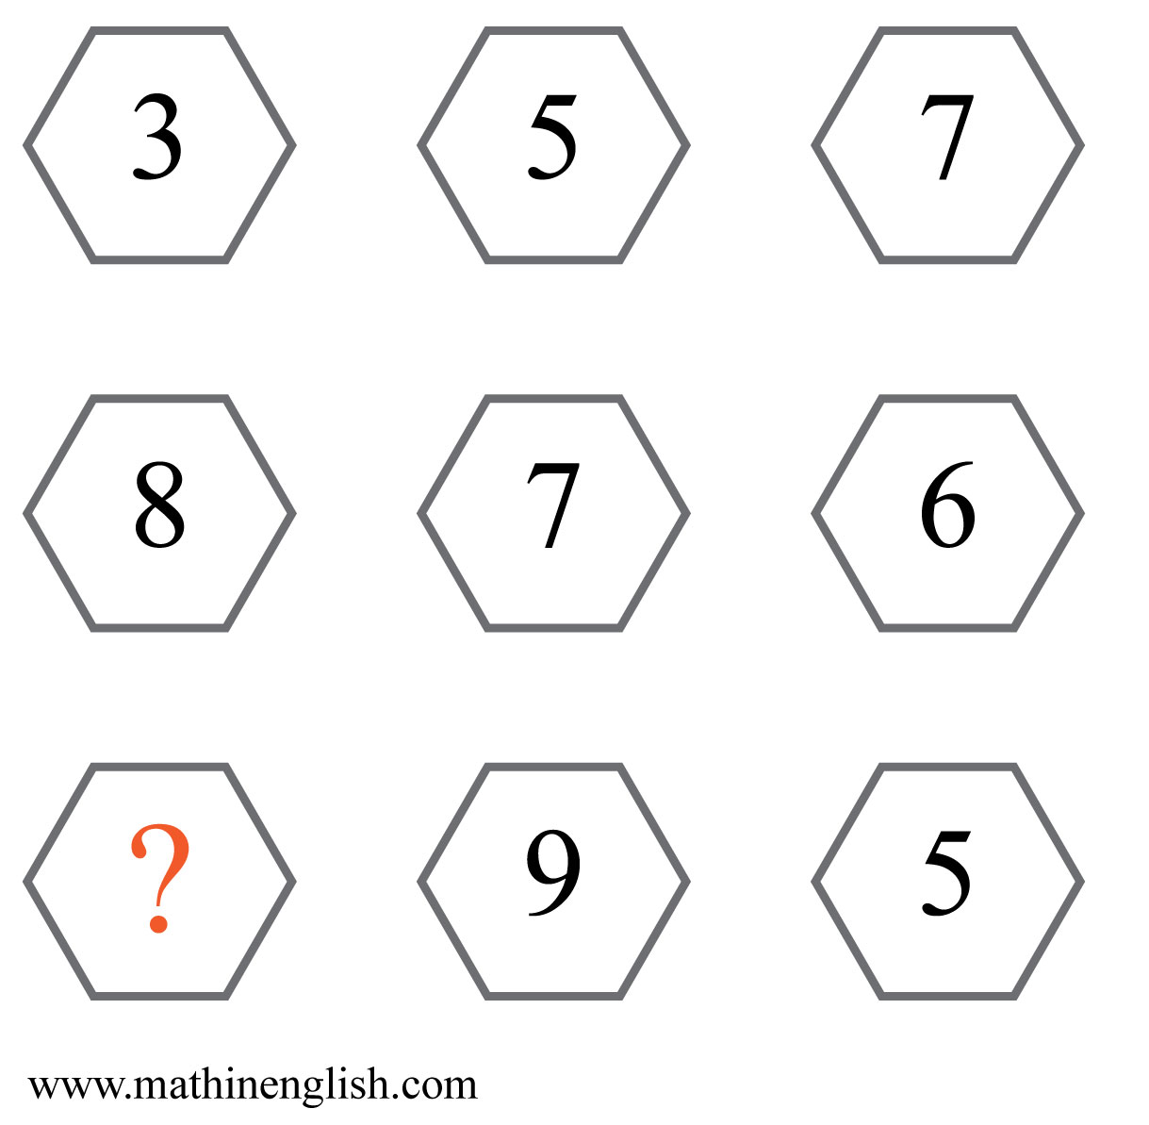
IQ Puzzle 9
Level 1A
Which number is missing?

Slide 11
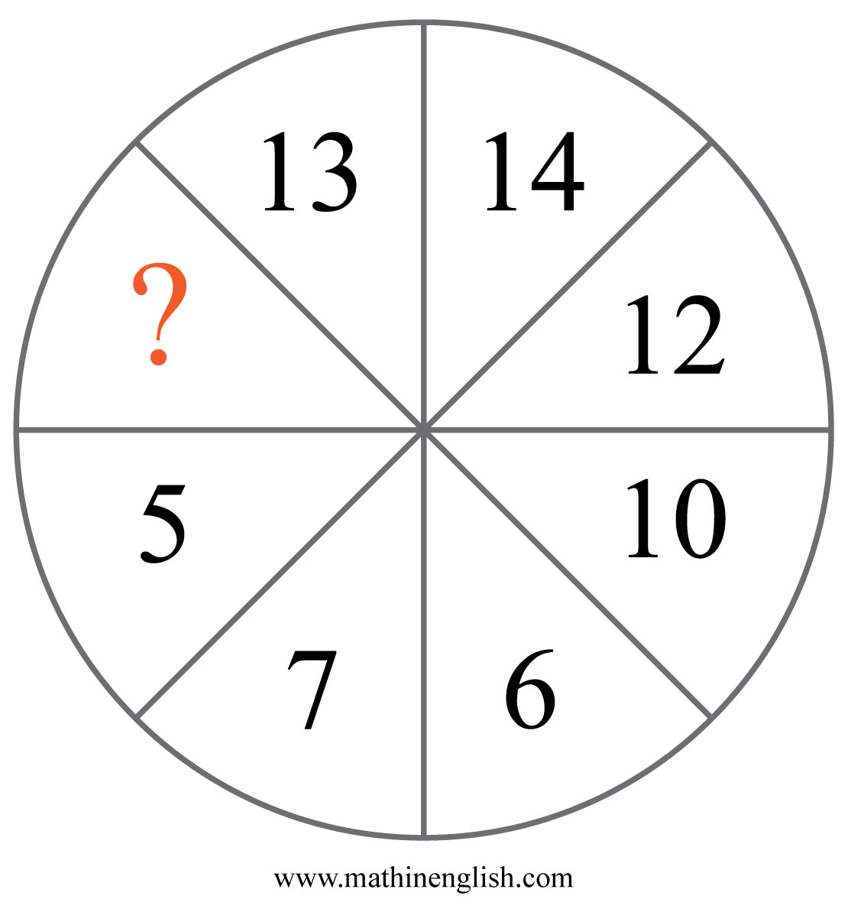
IQ Puzzle 10
Level 1A
Which number is missing?

Slide 12
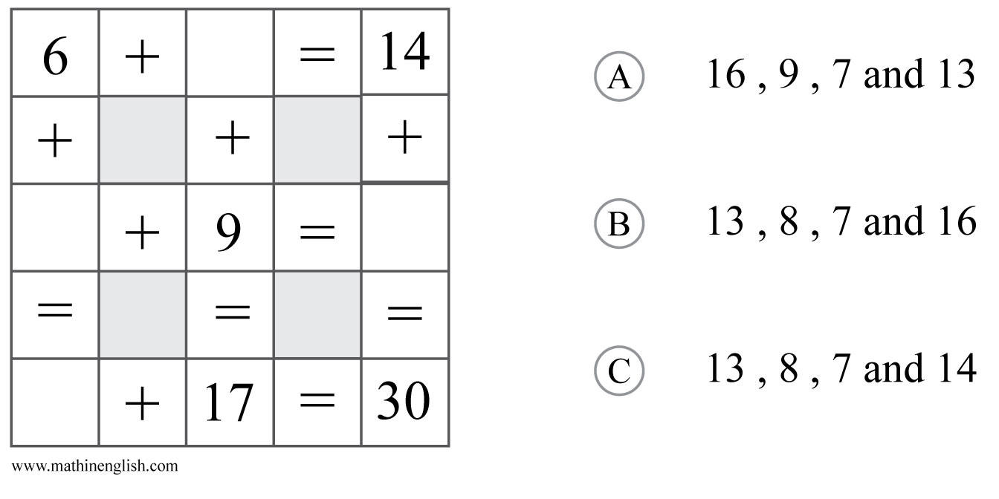
IQ Puzzle 11
Level 1A
Which 4 numbers are missing?

Slide 13
IQ Puzzle 12
Level 1A
Which letter is missing?

Slide 14
IQ Puzzle 13
Level 1A
What is the time on the 4th clock?

Slide 15
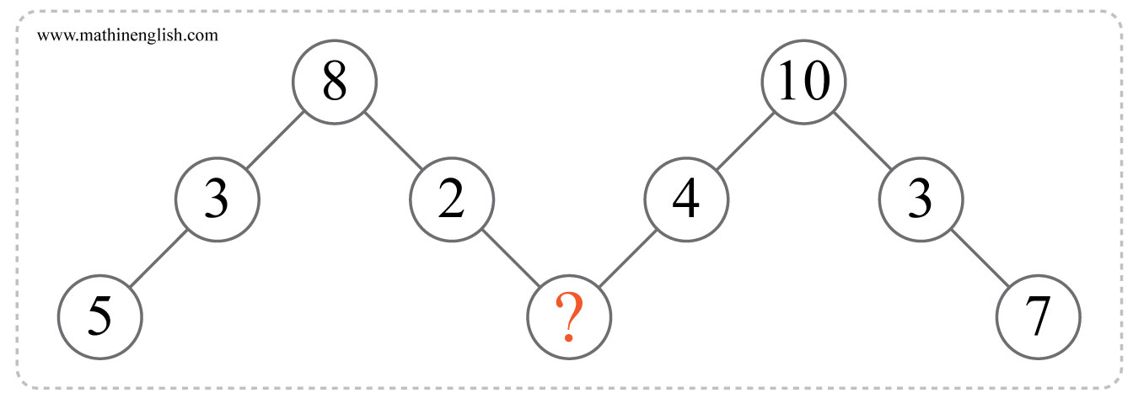
IQ Puzzle 14
Level 1A
Which number is missing?

Slide 16
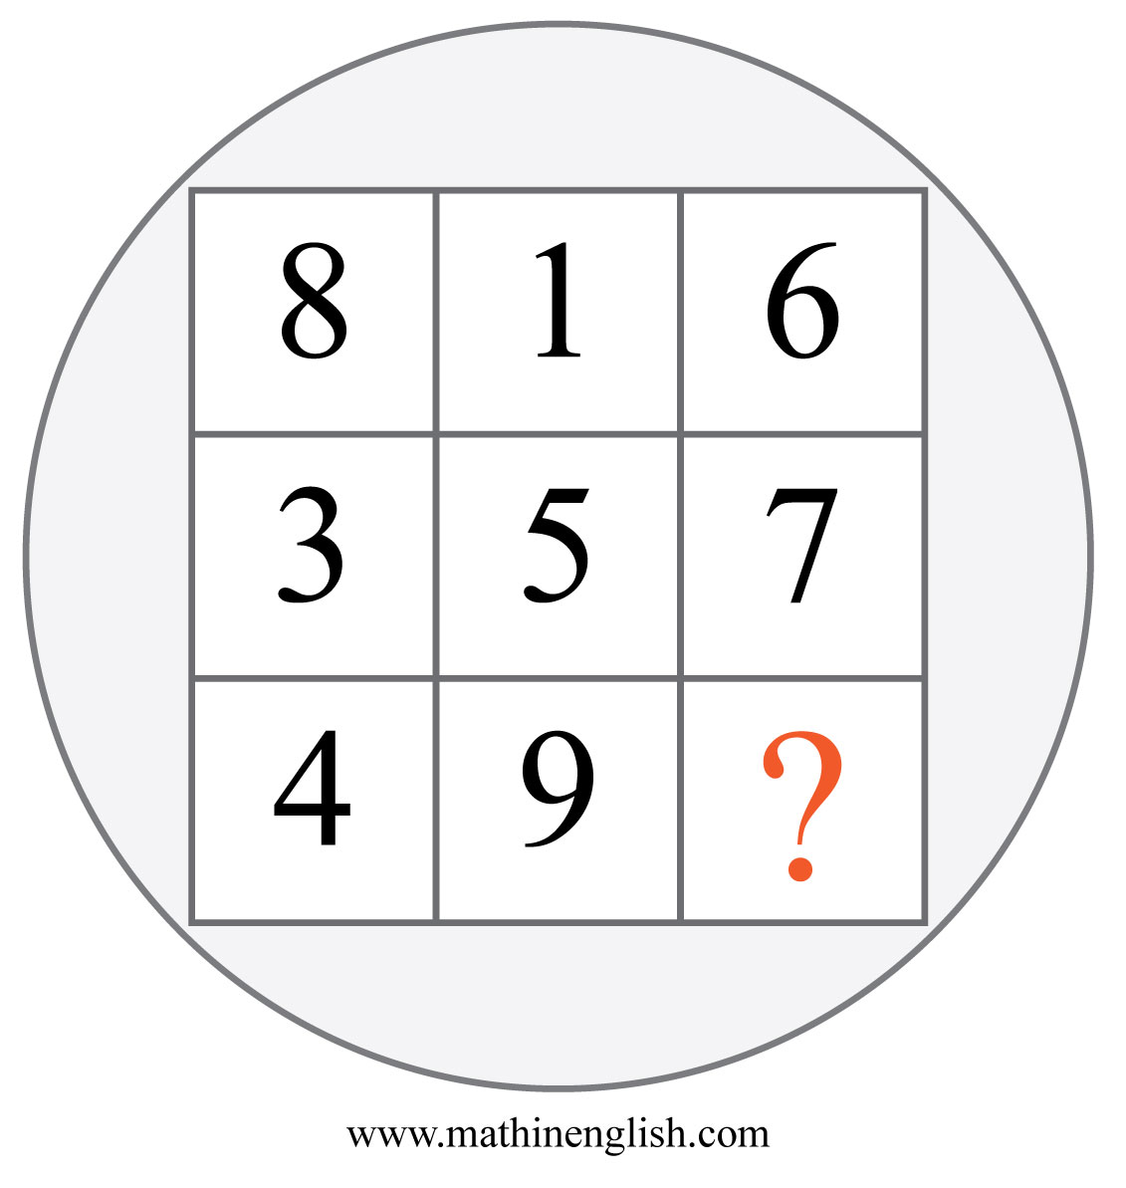
IQ Puzzle 15
Level 1A
Which number is missing?

Slide 17
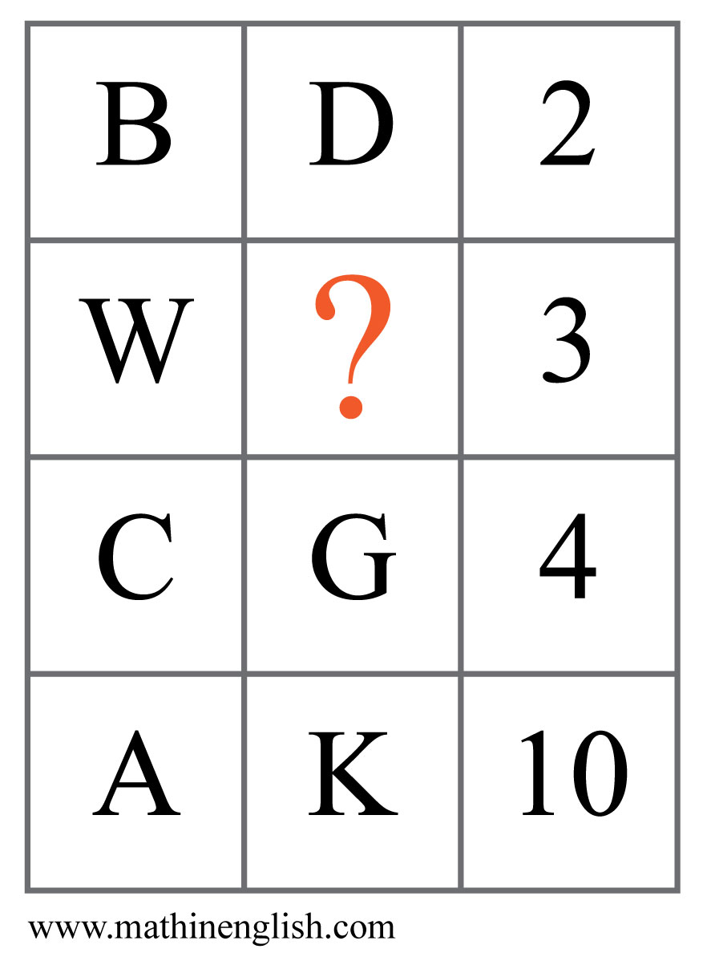
IQ Puzzle 16
Level 1A
Which letter is missing?

Slide 18
IQ Puzzle 17
Level 1A
Which number is missing?

Slide 19
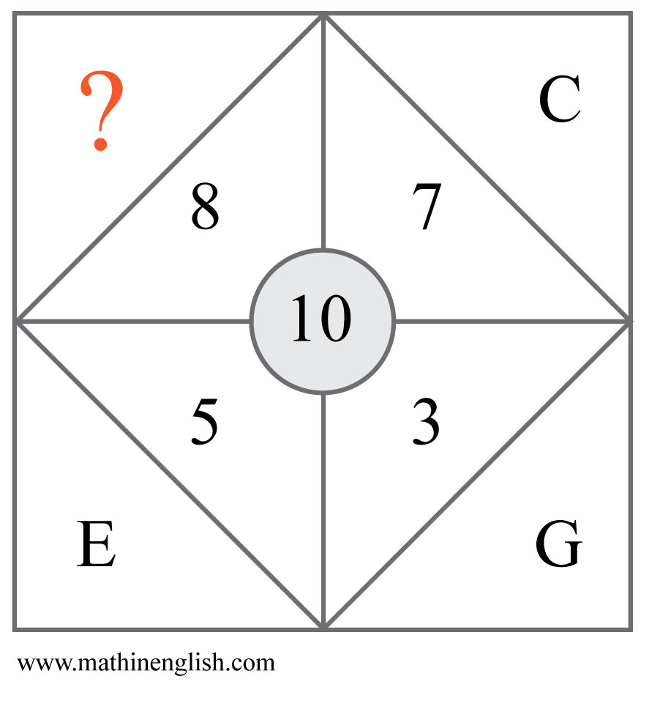
IQ Puzzle 18
Level 1A
Which letter is missing?

Slide 20
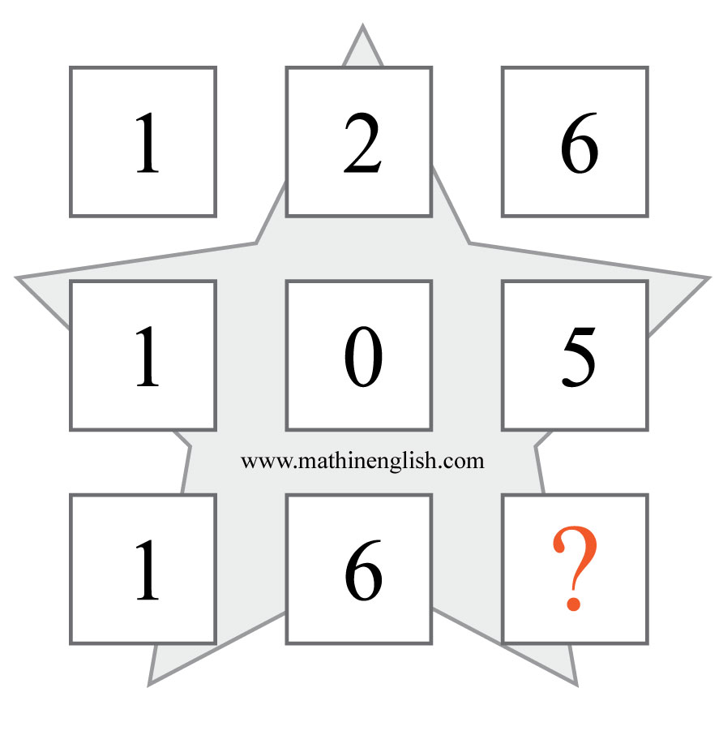
IQ Puzzle 19
Level 1A
Which number is missing?

Slide 21
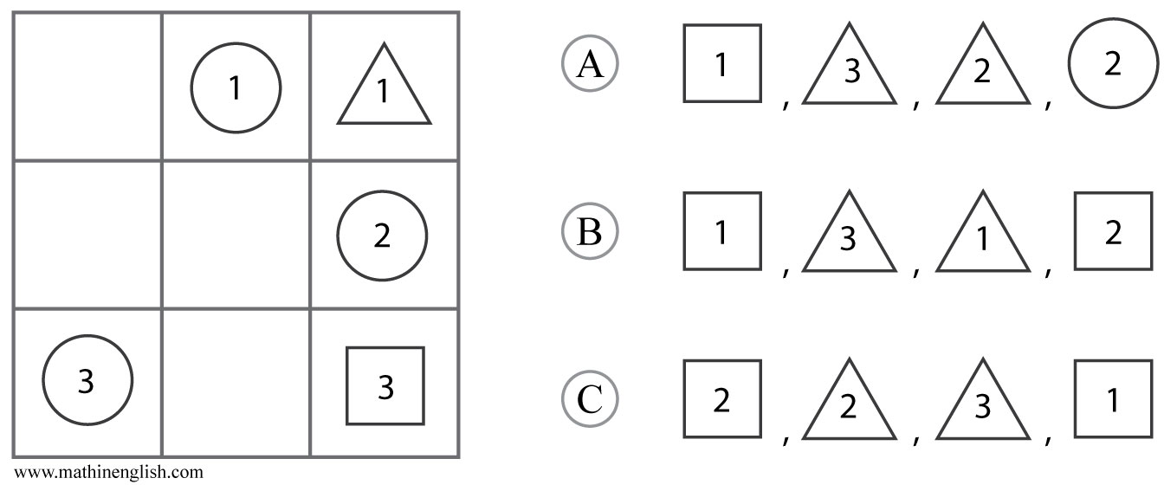
IQ Puzzle 20
Level 1A
Which shapes are missing?

Slide 22
Answers to puzzles 1 to 4
puzzle 1 : C
The dominoes follow a 0-2, 1-3, 2-4 pattern, with a difference of 2 between the top and bottom.
puzzle 2 : 12
The numbers 4 , 3 and 5 add up to 12.
puzzle 3 : K
The letter value increases by 2 each next cell.
puzzle 4 : 4
The difference between 3 and 7.
Copyright: www.mathinenglish.com
Level 1A

Slide 23
Answers to puzzles 5 to 8
puzzle 5 : C
The number of lines of each shape follows a +1 pattern.
puzzle 6 : 8
The average of 8 and 2 is equal to the middle number 5.
puzzle 7 : 5
The difference between the numbers in the inner and outer ring is 12. This means that A must be 5.
puzzle 8 : 28
The sequence follows a + 3, + 4, + 5, + 6 and + 7 pattern.
Copyright: www.mathinenglish.com
Level 1A

Slide 24
Answers to puzzles 9 to 12
puzzle 9 : 13
The average of 13 + 5 is 9.
puzzle 10 : 3
The difference between the opposite numbers is 7.
puzzle 11 : B
Fill in the numbers to check.
puzzle 12 : Q
Each letter number is 3 more than the previous one.
Copyright: www.mathinenglish.com
Level 1A

Slide 25
Answers to puzzles 13 to 16
puzzle 13 : 9 o’ clock
Each clock shows a time of 90 minutes later than the one before.
puzzle 14 : 6
6 is the difference between 8 and 2, 10 and 4.
puzzle 15 : 2
All rows and columns add up to 15.
puzzle 16 : Z
W plus 3 is 26, or Z.
Copyright: www.mathinenglish.com
Level 1A

Slide 26
Answers to puzzles 17 to 20
puzzle 17 : 13
-3, -4, -5 and so on.
puzzle 18 : B
B plus 8 makes 10.
puzzle 19 : 8
The first 2 cells in a row divided by 2 form the value of the 3rd cell.
puzzle 20 : C
Each row contains a circle, square and triangle, with a 1 for row 1,
a 2 for row 2, etc.
Copyright: www.mathinenglish.com
Level 1A

